Slide 1
Enabling Strategic Growth Through Digital Transformation
Casey Quach, Tommy Tran, Saijal Sobti, Jose Larenas Coronel

Slide 2
Executive summary
Revenue goal: $33M → $72M in 3 years
Team size: 36 → 70+ employees
Strategy focus: Sales, Warehouse Ops, Accounting, HR, Executive, IT
Goal: Deploy scalable and secure digital solutions aligned with sustainable profitable growth revenue

Slide 3
01
Analysis &
Recommendations

Slide 4
Transformation Targets by Function
Function | Proposed Solution
Sales | CRM
Warehouse Ops | IMS + LMS
Accounting/Finance | Quickbooks Integration
IT | Service Desk Platform + Zero Trust Tools
Executives | BI Dashboard
Human Resources | ADP Enterprise Edition

Slide 5
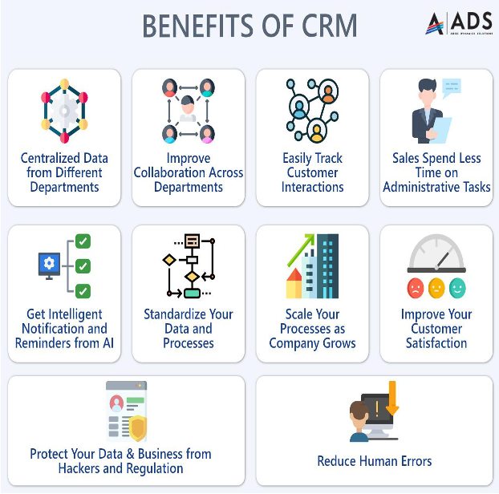
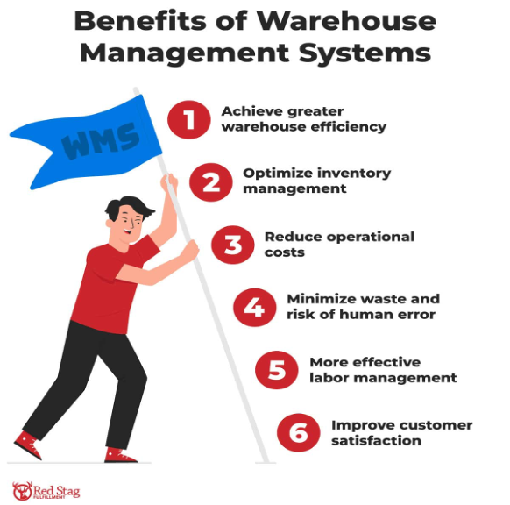
Key Benefits
Zoho Customer Relationship Management
Zoho Inventory Management System
Boost Sales by 29%
Increase Retention by 15%
10–15% Productivity Boost
89% Staff Satisfaction
Save 30% Time
Improve Forecasts by 40%
Reduce Errors by 66%–97%
Notes:
May not need the explanation in each point. We should just put the bolded parts then explain it when we present.
CRm
Boost Sales by 29%: CRM streamlines lead nurturing and sales automation.
Increase Retention by 15%: AI-enhanced CRM deepens customer relationships.
10–15% Productivity Boost: with AI-powered assistance
89% Staff Satisfaction with automated tools and task management
ims
Save 30% Time: Automated inventory tracking cuts ordering and tracking time for managers.
Improve Forecasts by 40%: AI-based IMS boosts demand prediction accuracy.
Reduce Errors by 66%–97%: Automation cuts human mistakes.

Slide 6
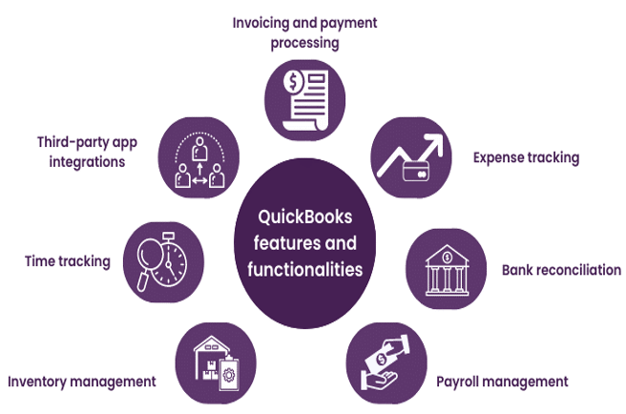
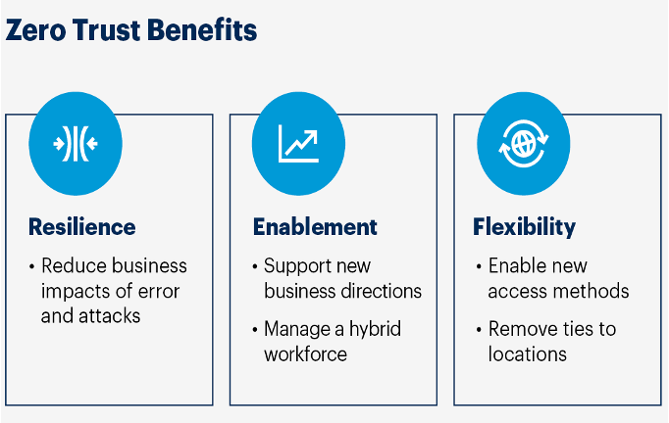
Key Benefits
Quickbooks Enterprise
Zoho Service Desk Platform + Cisco Duo
Saves 20+ hrs/week on manual finance tasks
Improves accuracy with automation
Accurate Job Costing
Minimize downtime
Enhanced user experience
99% Reduction in Account Compromise Risk
59% Fewer Passwords
Notes:
May not need the explanation in each point. We should just put the bolded parts then explain it when we present.
QB
Saves 20+ hrs/week on manual finance tasks
Improves accuracy with automation
Accurate Job Costing: Track labor, materials, and overhead in detail
Supports Scalable Growth
Service desk Zero trust
99% Reduction in Account Compromise Risk: MFA limits unauthorized access
59% Fewer Passwords to remember
Enhanced Resilience across departments
Flexibility: Allows secure access from anywhere

Slide 7
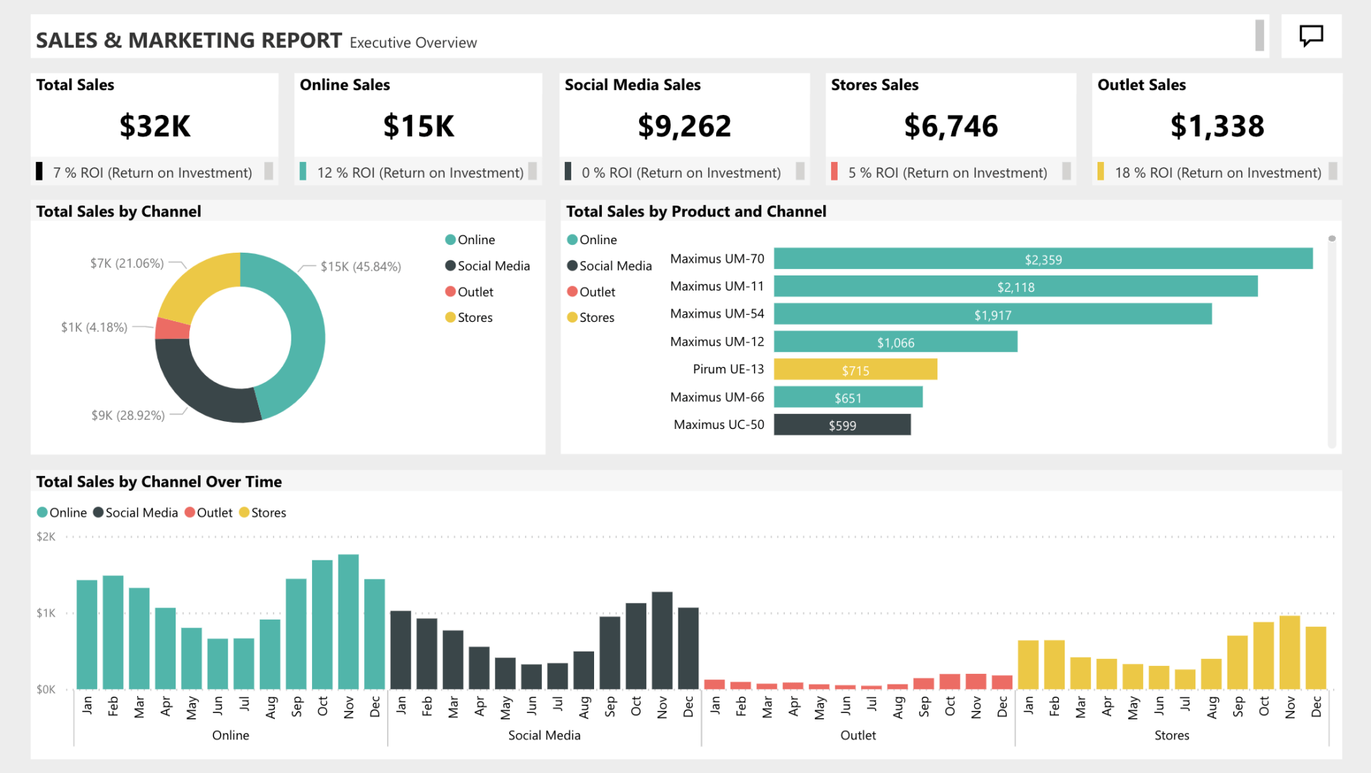
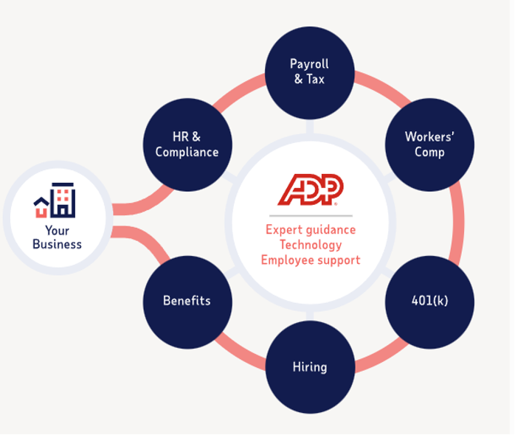
Key Benefits
Zoho Analytics
ADP Enterprise Edition
Boosts HR Productivity and lowers workload by 72%
Onboarding improves 5×; turnover drops by 30%.
Supports Revenue Growth
Reduce Training Effort up to 40-60%
Increased Data Accuracy & Confidence
Time Savings by 256 hours per person annually.
Faster Decision-Making
Notes:
May not need the explanation in each point. We should just put the bolded parts then explain it when we present.
Increased Data Accuracy & Confidence: Reliable data supports smarter decisions.
Time Savings: Automates reports, saving 256 hours per person annually.
Faster Decision-Making: AI dashboards speed up insights and actions.
Boosts HR Productivity: Automation improves efficiency and lowers workload by 72%.
Higher Engagement, Lower Turnover: Onboarding improves 5×; turnover drops by 30%.
Supports Revenue Growth: Automates HR tasks and enhances compliance & analytics.
Reduce Training Effort up to 40-60%

Slide 8
02
Infrastructure

Slide 9
IT Infrastructure
Current IT Problems:
Outdated Hardware
Limited Network/Security
Lack of Remote Access
Solutions:
Upgraded Hardware
Cisco Meraki
Improved firewalls, WiFi, and VPN connection
Notes:
Outdated Hardware: Especially desktops, laptops
Limited Network/Security: Everything ranging from WiFi, switches, and routers are not business grade or managed.
Lack of Remote Access: No VPN or proper firewall in place to ensure secure remote connectivity.

Slide 10
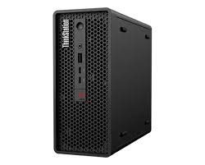
Main Hardware Upgrades
Microsoft Surface Pro 11
Lenovo ThinkStation P3 Ultra Small Form Factor Workstation
Samsung S24 (128GB)

Slide 11
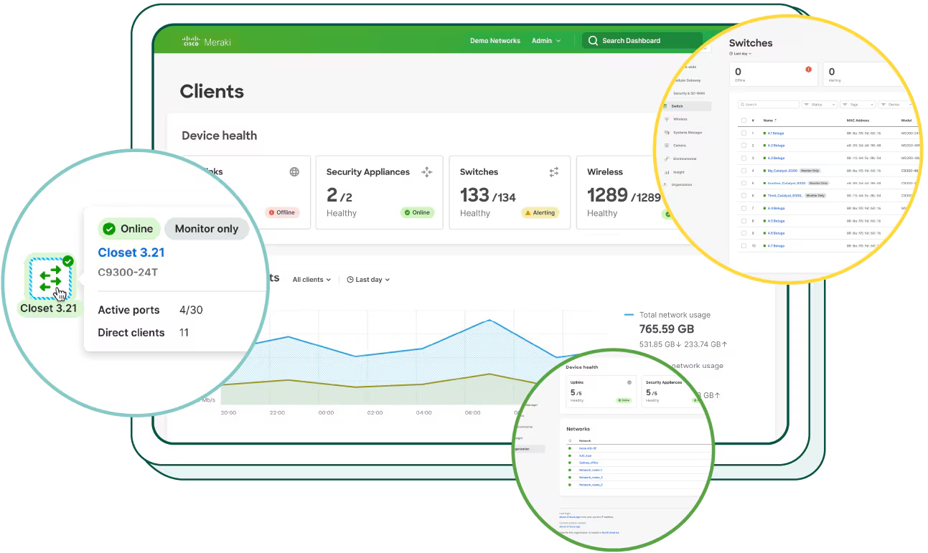
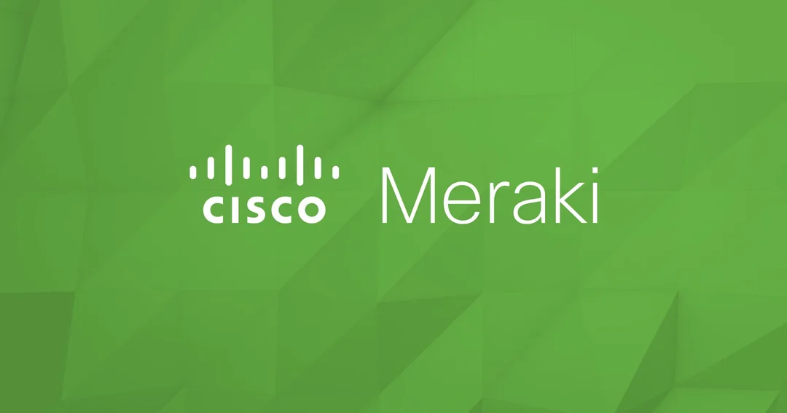
Cisco Meraki
Centralized Management
Built-In Security & VPN
Scalable & Reliable

Slide 12
Infrastructure Diagram (Remote)

Slide 13
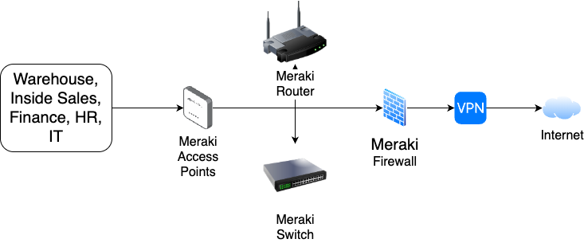
Infrastructure Diagram (In-Person)

Slide 14
03
Risk & Mitigation

Slide 15
Risks & Mitigation
Risk 1: Data Migration
Transitioning to enterprise systems may include, data loss, inconsistencies, & disruption of daily operations.
$100 M
Mitigation:
Testing
Backup data

Slide 16
Risks & Mitigation
Risk 2: Cybersecurity
Data breaches and cyber attacks are a significant risk during digital transformation especially while companies are implementing multiple new systems.
Mitigation:
Multi-Factor Authentication (MFA)
Data Backup and Recovery Plan
Notes:
Multi-Factor Authentication (MFA): Prevents unauthorized access
Phase-by-phase rollout aligned to comfort levels.
Digital learning hub + training modules

Slide 17
Risks & Mitigation
Risk 3: Employees Resistance to Change
Employees may resist new systems due to comfort with existing tools, lack of confidence, or fear of added workload.
$100 M
Mitigation:
Communicate Benefits
Offer Training/ Phase-by-phase rollout aligned to comfort levels.
Notes:
Phase-by-phase rollout aligned to comfort levels.
Digital learning hub + training modules

Slide 18
04
Timeline
JANUARY
FEBRUARY
MARCH
APRIL
MAY
JUNE
PHASE 1
Task 1
Task 2
PHASE 2
Task 1
Task 2

Slide 19
Transformation Plan Timeline

Slide 20
05
Budget

Slide 21
Budget Information
 | Y1 | Y2 | Y3 | Total
Software | $ 55,017 | $ 78,585 | $ 104,697 | $ 238,299
Hardware | $ 56,712 | $ 56,712 | $ 24,799 | $ 138,223
Data | - | - | - | -
Infrastructure | $ 15,633 | $ 11,257 | $ 11,657 | $ 38,547
Other | - | - | - | -
Total | 127,362 | $ 114,641 | $142,331 | $384,335
Detailed Budget Table

Slide 22
Conclusion
Enhances existing operations with limits to full system replacements
Preserves institutional knowledge during workforce transition
Enables secure, remote, multi-office coordination
Aligns IT with business strategy for long-term resilience
Notes:
Supports growth to $72M through scalable digital tools

Slide 23
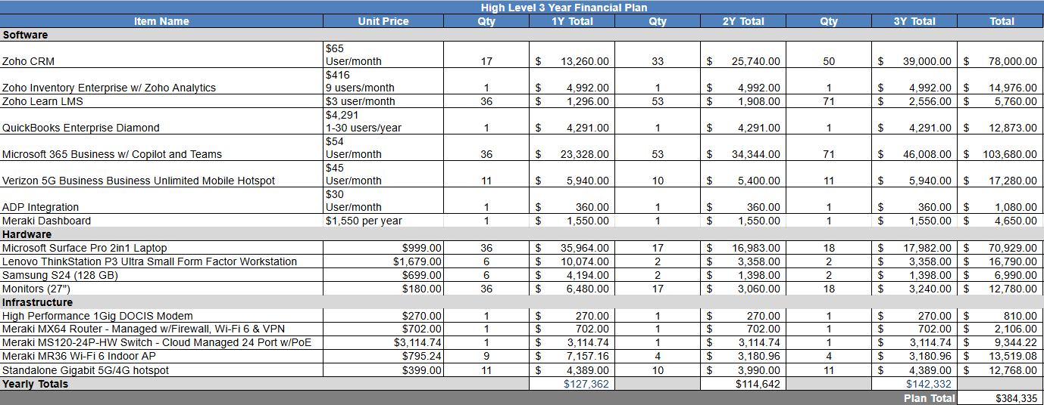
Appendix - Budget
Simplified Budget Table

Slide 24
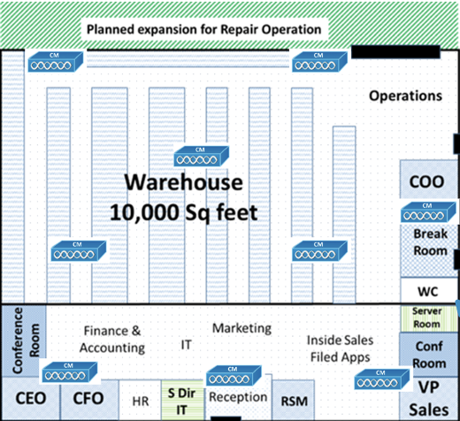
Appendix - Infrastructure

