Slide 1
Database Management System Transformation
Team 3: Casey Quach, Jarod Larot, Derek Casas, Alan Plascencia Macias, Gurkamal Maan, and Zeynelabidin Zeynelabidin

Slide 2
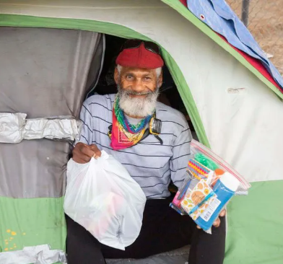
Overview
CityTeam is a Christian non-profit organization that serves people in need by addressing poverty, hunger, homelessness, and addiction.
The organization accepts Gift-In-Kind (GIK) donations and currently tracks them using Excel Spreadsheets.
Due to the limitations of the current method, CityTeam wants to adopt a new system.
CityTeam wants us to implement a structured database management system (DBMS) to replace spreadsheets to streamline the donation tracking process.
Notes:
Jarod

Slide 3
The Problem
Problem
Requirements
Proposed Solution
Time Consuming Processes
Error Prone
Various regions have different data
No data insight
Security of data/ access controls
Ease of Use
Multi-regional
Flexible Data Entry
Cost Sensitivity
Data Reporting
Data Security
Scalable
DonorPerfect Provides
GIK management
Donor tracking
Reporting/Analytics
User access/Data Security
Ease of use
Cost Efficiency
Notes:
Alan

Slide 4
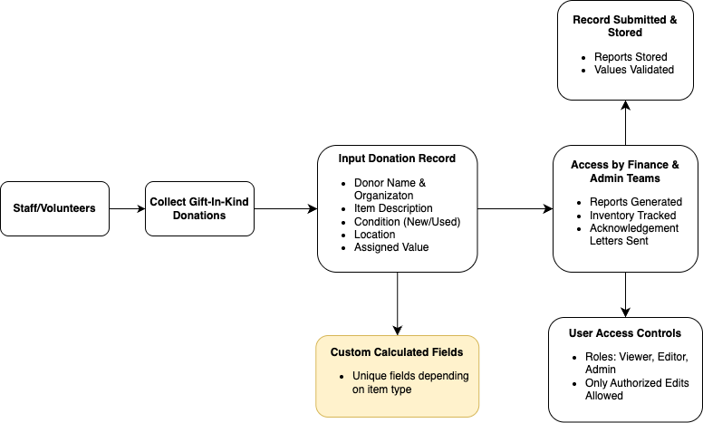
Business Flow Diagram
Notes:
Casey

Slide 5
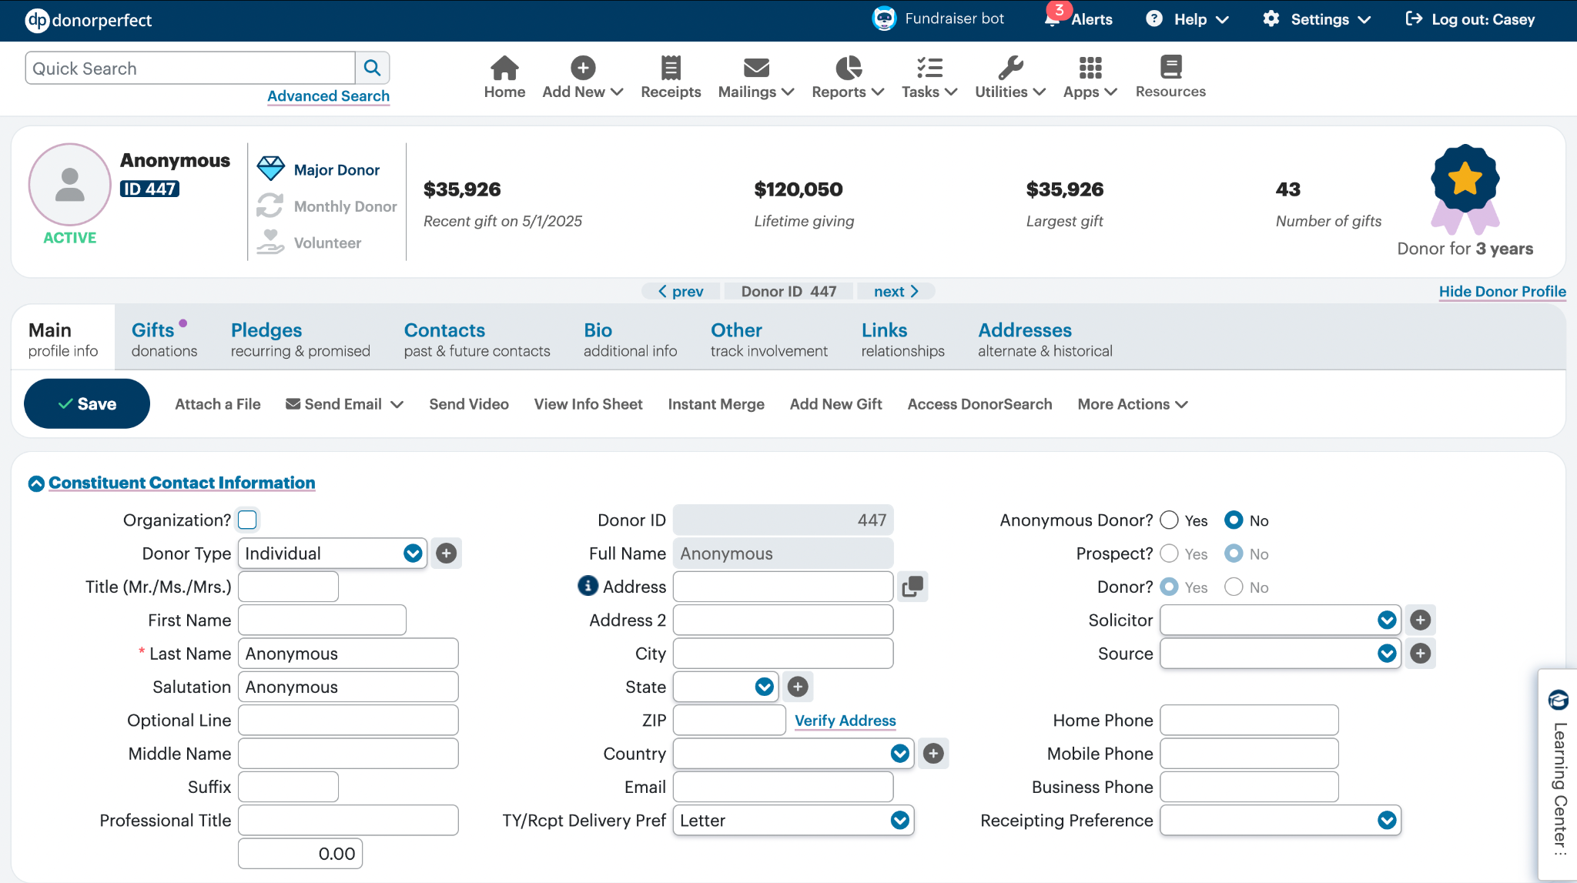
Demo of Solution (Donor Screen)
Challenge 2
Challenge 3
Notes:
Casey

Slide 6
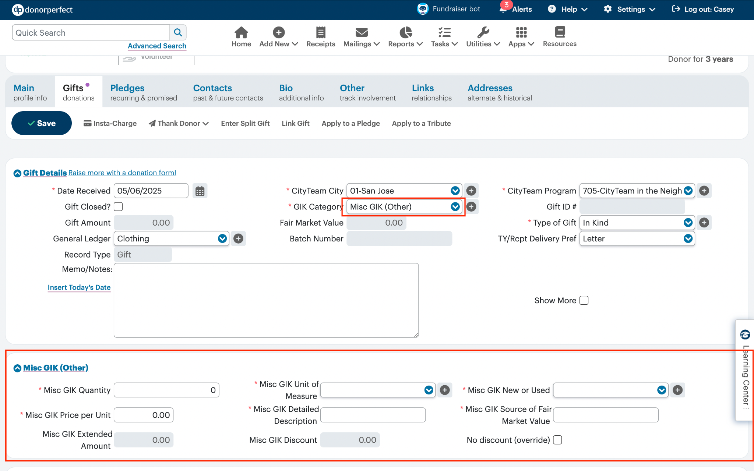
Demo of Solution (Gift Entry)
Inputting Gifts
Challenge 2
Challenge 3
Notes:
Casey

Slide 7
Scope Management
Components of Scope ✅
Assist with implementing a suitable DBMS (DonorPerfect)
Migrate historical and current GIK data by city and program
Define standard GIK statistics, data valuation, and measurements
Enable program staff to easily input monthly data and track inventory
Support quarterly reporting and journal entry creation for finance team
Enable flexible reporting by city, category, and time period
Beyond Scope 🚫
Full custom software or app development
Ongoing system maintenance or support post-deployment
Redesigning of CityTeam’s year-end inventory processes beyond integration
Deliverables 📄
Configured DBMS (DonorPerfect)
Migrated GIK data
User training demos and walkthrough
Key Constraints 📎
Limited availability of CityTeam staff
Alignment with project deadlines
Existing data inconsistencies
Revision Approval Process ✅
Internal review by team for changes to scope or deliverable
Present proposed changes to Andrea Elliott (project sponsor) for approval
Document approved changes put in shared team workspace and update timeline accordingly
Notes:
Components of Scope
Beyond Scope
Deliverables
Key Constraints
Revision Approval Process

Slide 8
Risk Management
Risk | Impact | Mitigation Strategy
Data Migration Errors | High | Perform test migrations, backup all data, and validate data after import
User Resistance to New System | Medium | Offer hands-on training, provide support materials, and gather user feedback
Integration Issues with Donorperfect | High | Test API integrations early, consult DonorPerfect support, and have rollback plans
Donor Data Security Breach | High | Enable secure access, use 2FA, restrict user roles, and conduct regular audits.
Notes:
A table showing (Risks | Impact (Low, Medium, High) | Mitigation Strategies

Slide 9
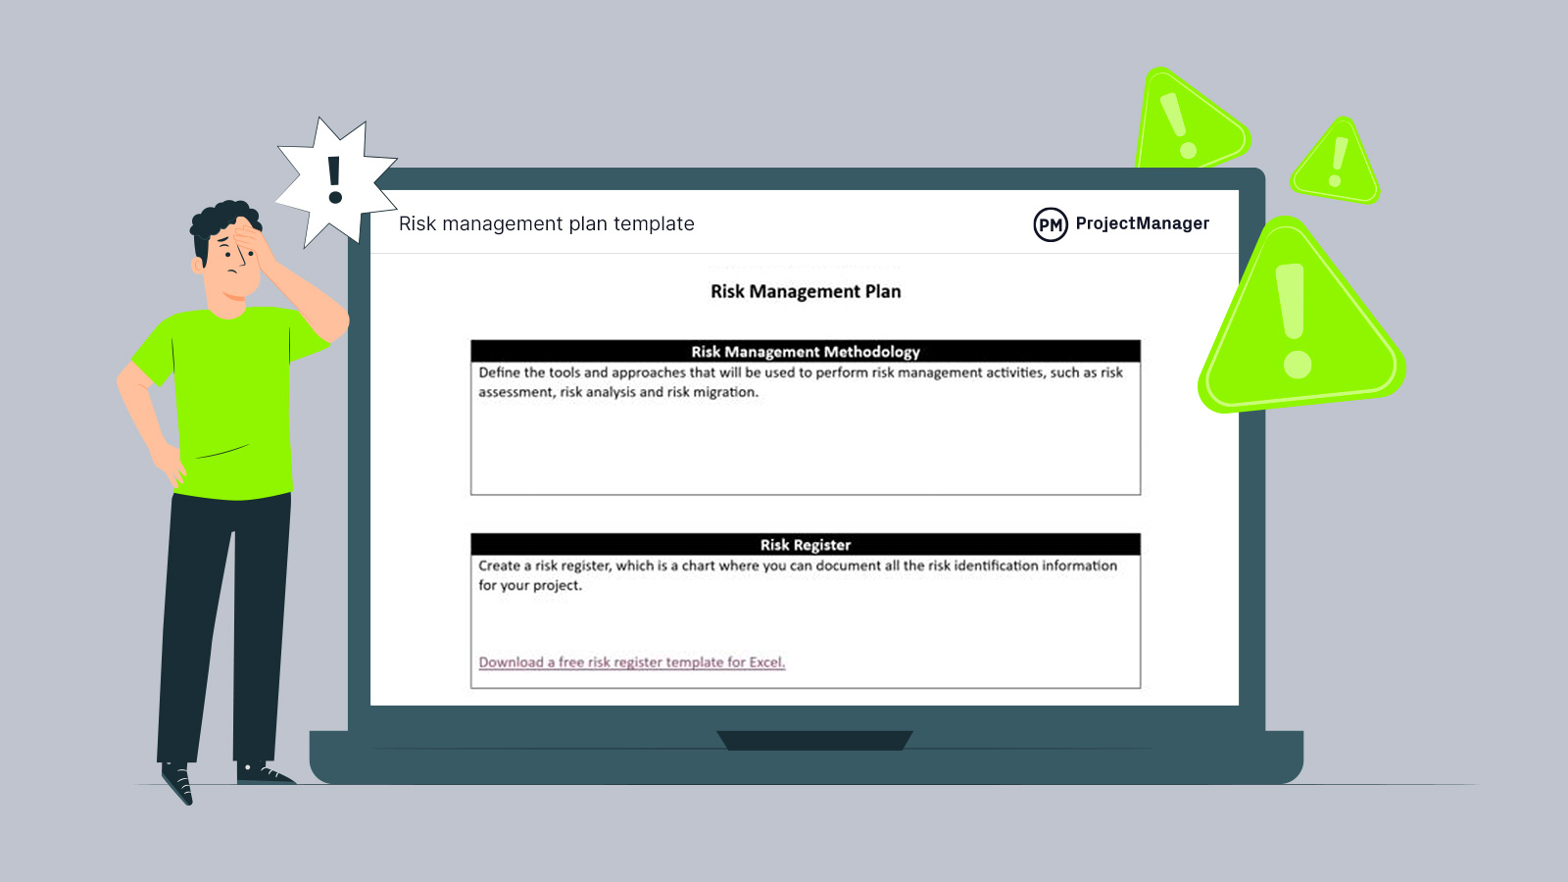
Risk Response Plan
Proactive Training & Support
Deliver targeted training sessions for all DonorPerfect users before full implementation.
Provide access to quick-reference guides and video tutorials.
Regular Data Quality Checks
Schedule weekly audits to identify incomplete or inconsistent donor records.
Implement data entry validation rules within DonorPerfect to prevent common input errors.
Technical Safeguards & Backups
Enable two-factor authentication (2FA) for all users.
Perform regular data backups and test recovery protocols monthly.
Notes:
3-4 points on how we plan to address the overall risks

Slide 10
Communication Management
Establish clear channels for team communication (e.g., Slack, Email)
• Weekly check-ins to update on deliverables and align on goals
• Feedback loop with CityTeam to ensure expectations are met
• Documented communication logs for accountability and reference
Notes:
How will we handle communication management with CityTeam (3-4 points)

Slide 11
Change Management
• Identify key stakeholders impacted by DBMS change
• Communicate benefits of DonorPerfect to reduce resistance
• Provide user training and post-implementation support
• Monitor adoption and collect feedback for improvements
Notes:
How will we handle change management with CityTeam (3-4 points)

Slide 12
THANK YOU

