Slide 1
New International Venture
By Khanh Nguyen, Jasmin Lall, Amy Mei, Kelvin Thit, Samuel Pak, Trevon Lofton
Notes:
Khanh

Slide 2
Table of Contents
01
Background
02
Determining the Target Country
03
Cultural Environment
04
Political Environment
05
Economic Environment
06
References
Notes:
Khanh

Slide 3
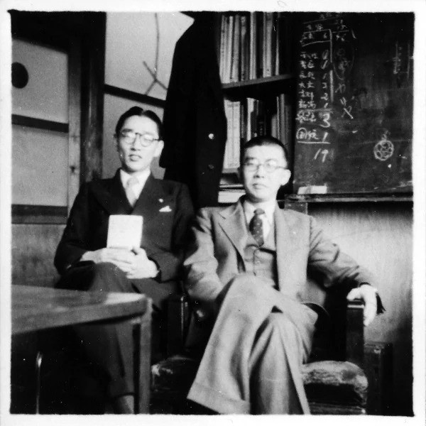
Background
First Established in 1946 by Ibuka and Morita under the name (Toyoko Telecommunication Engineering Corporation)
Starting off with only 190,000 yen and about 20 employees
The founders hope to rebuild and expand on Japan’s culture through manufacturing and dynamic technological ventures
The focus of the company was to create sense of open mindedness and freedom through their technological innovations
Khanh Nguyen (Sony, 2024)
Notes:
Khanh

Slide 4
Timeline of Impactful Innovation
1946
1955
1982
2003
First established
TR-55
CDP-101
BDZ-S77
Tokyo Telecommunication Engineering Corporation
Japan’s first transistor radio was introduced
The world’s first CD player
The world’s first Blu-Ray Disc Recorder
1950
1965
1994
G-Type
CV-2000
PlayStation
Japan’s first magnetic tape recorder was introduced
World’s first consumer- use open reel VTR
Launch of the PlayStation home video game console in Japan
Khanh Nguyen (Sony, 2024)
Notes:
Khanh

Slide 5
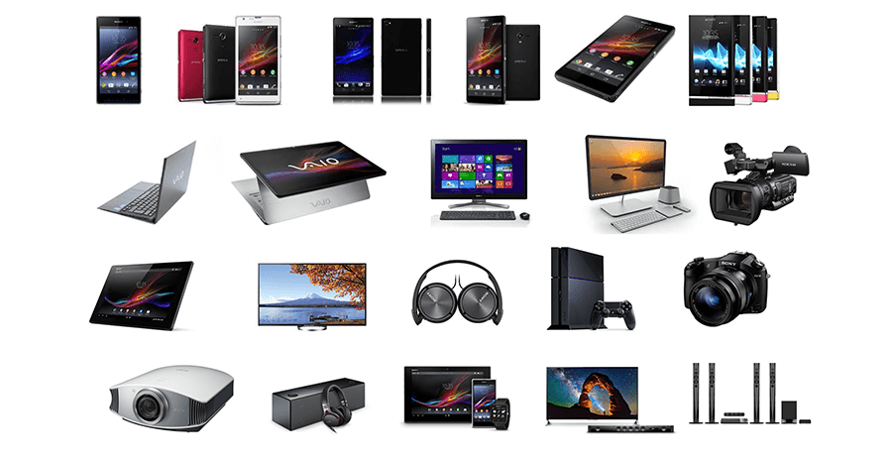
Sony (Currently)
Khanh Nguyen(Laposky & Wolf, 2015), (Sony, 2024)
Phased out all of their stores throughout the years
Instead sony has 284 authorized dealers that either sell or incorporate the products in some way.
Also Sony does sell their products on the Sony website (https://electronics.sony.com/)
Offering Products and Services in Gaming, Entertainment, Music, and many more
Notes:
Khanh

Slide 6
Mission/Vision Statement
“A company that inspires and fulfills your curiosity”
“Using our unlimited passion for technology, content and services to deliver groundbreaking new excitement and entertainment, as only Sony can.”
Khanh Nguyen (Sony, 2024)
Notes:
Khanh

Slide 7
02
Determining the
Target Country

Slide 8
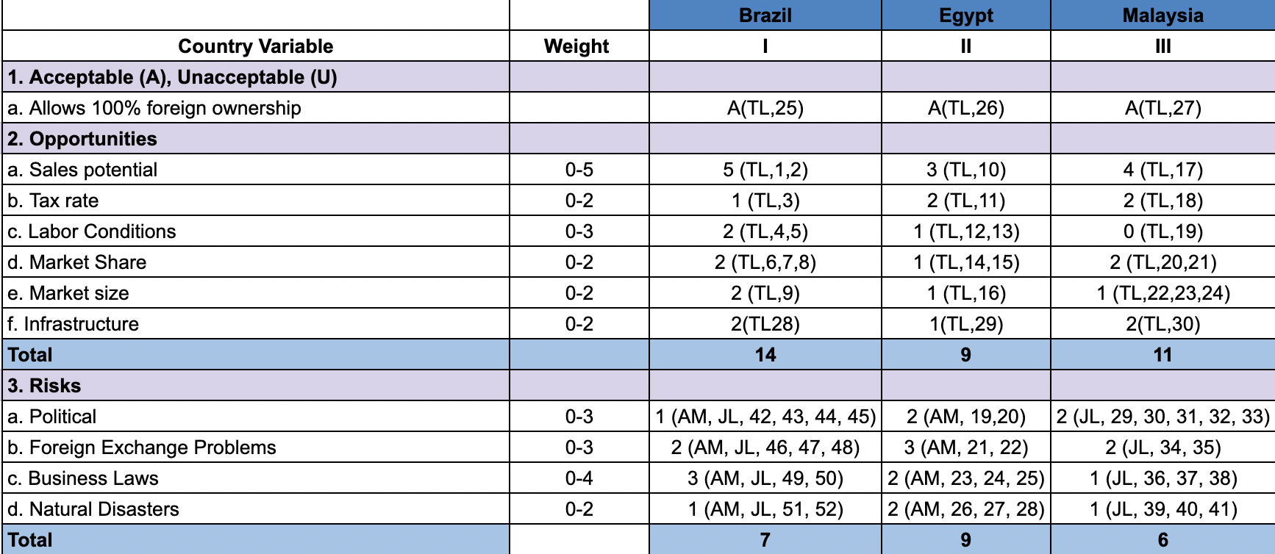
Simplified Market-Penetration Grid
[Insert Grid Here]
(Amy Mei, Jasmin Lall, Trevon Lofton)

Slide 9
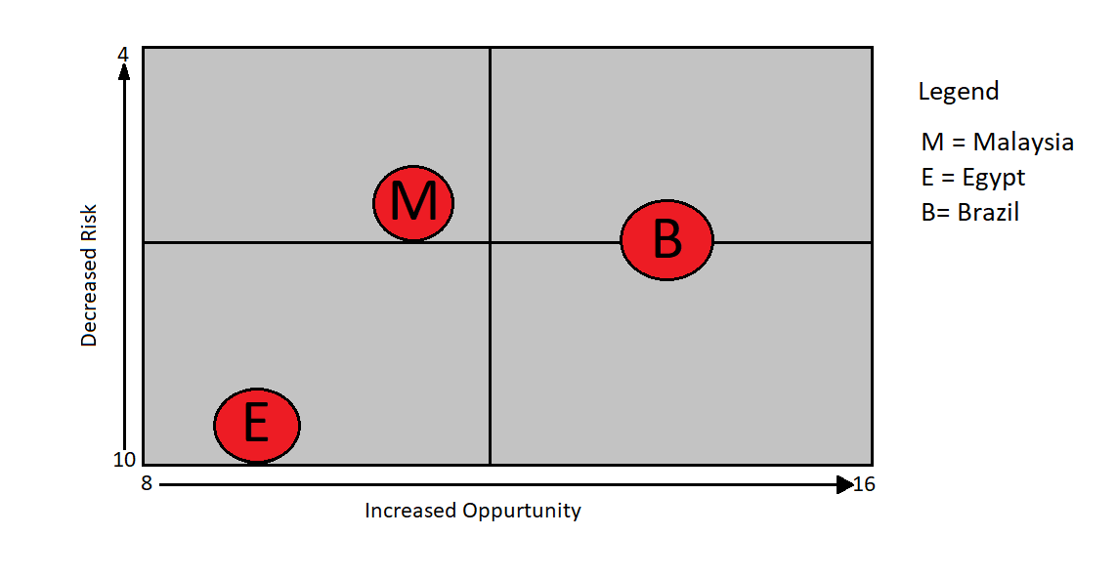
Opportunity-Risk Matrix
Trevon Lofton

Slide 10
Target Country Profile
Malaysia

Slide 11
03
Cultural Environment

Slide 12
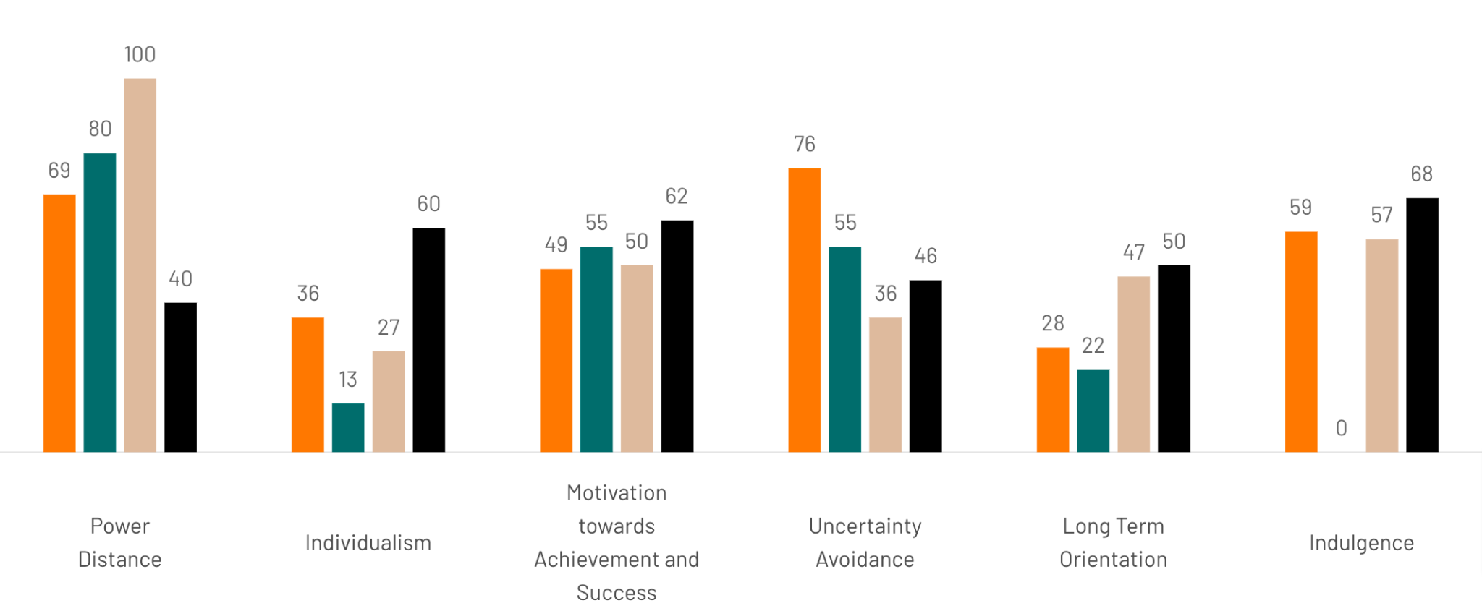
Cultural Dimensions
Khanh Nguyen (Hofstede Insights)
Notes:
To really understand the cultural dimensions, you first need to understand that Malaysia is heavily a collective society that is built on a hierarchy. Meaning that people within it tend to not challenge their superiors, that is why power distances is so high. This also factors into individualism as well, making on the lower scale, since in a collective society, people tend not wanting to stand out.

Slide 13
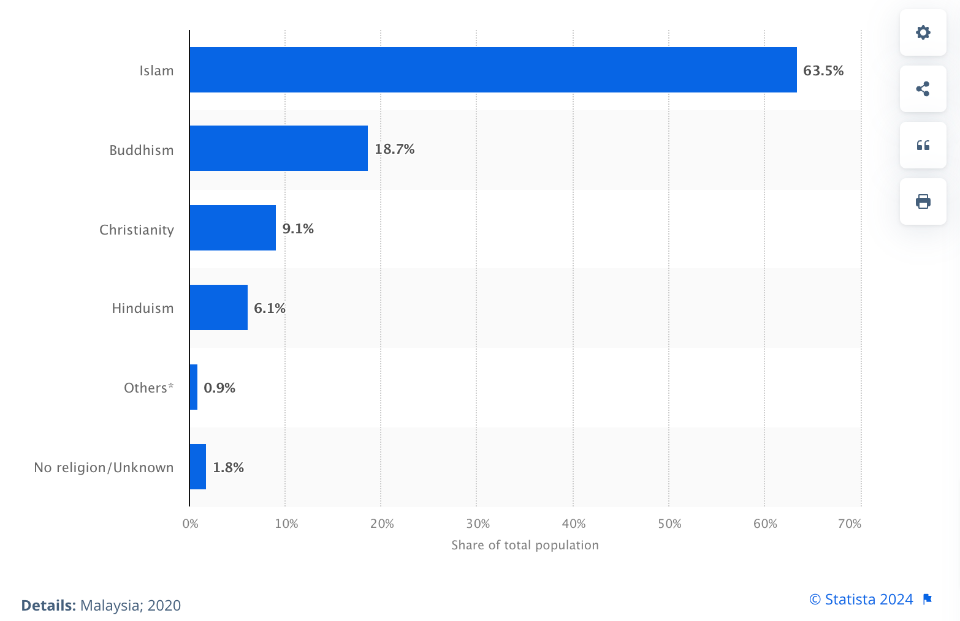
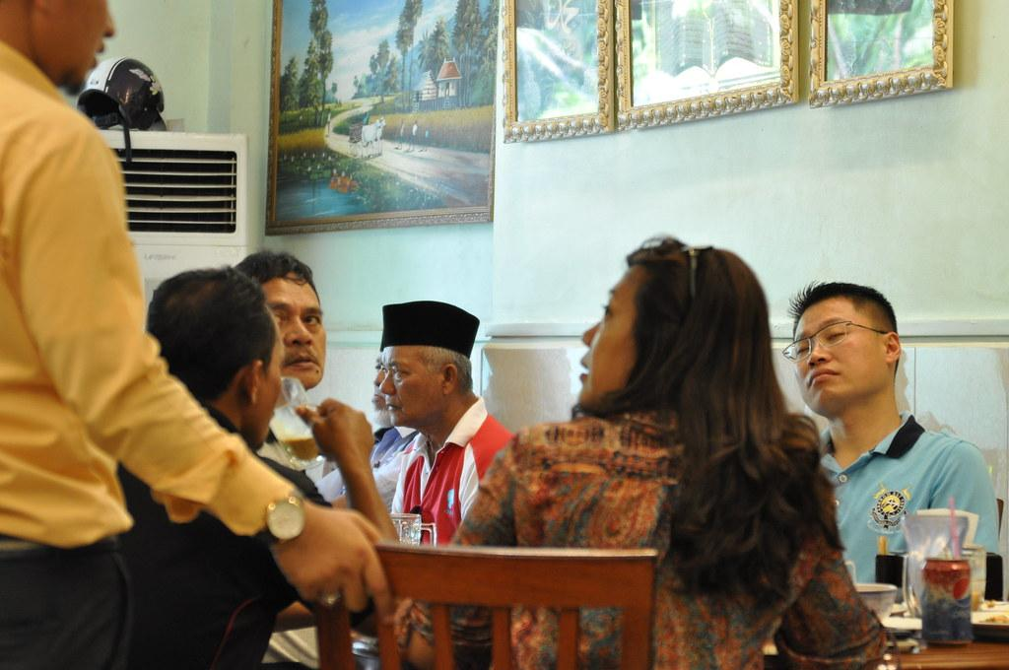
Religion and Family
Khanh Nguyen (Hofstede Insights,2024), (Statista,2024), (Habib,2013), (Evason, 2016)
Islam technically is the official religion
Due to the early Trading of the late 13th to 15th century
Integrated many Muslims people in Malaysia due to this
Large families are preferred
The male is usually the dominant decider in the family
Importance of age in a family household
Notes:
Khanh

Slide 14
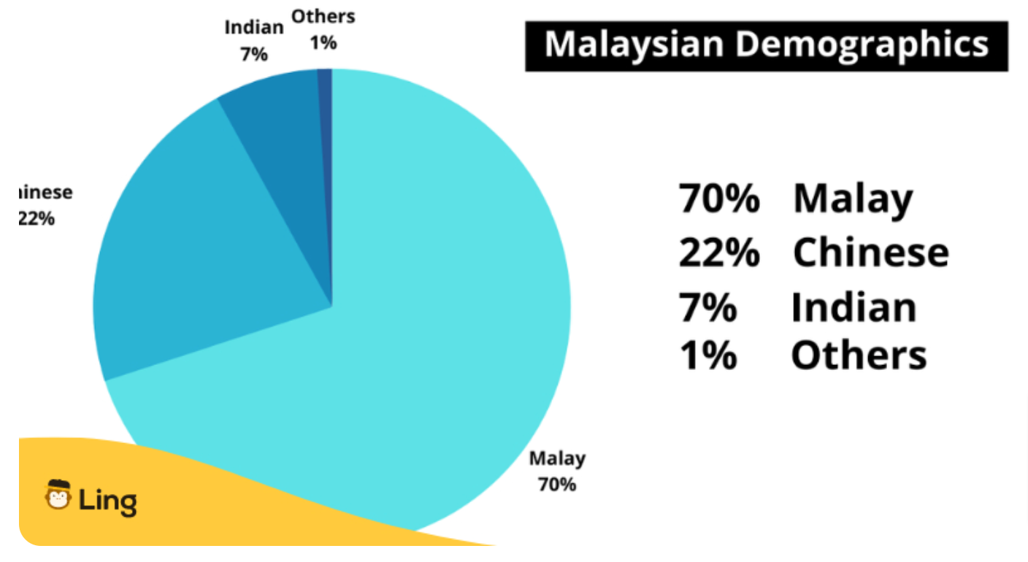
Language and Communication
Khanh Nguyen (ling, 2023), (FamilySearch, 2023)
The three main languages used in Malaysia is Malay, Mandarin, and Tamil
Malay being the most dominant language
Language used in business may vary
Private sectors tends to use more english while public ones uses Malay
(Yahaya, 2023)
Notes:
Khanh

Slide 15
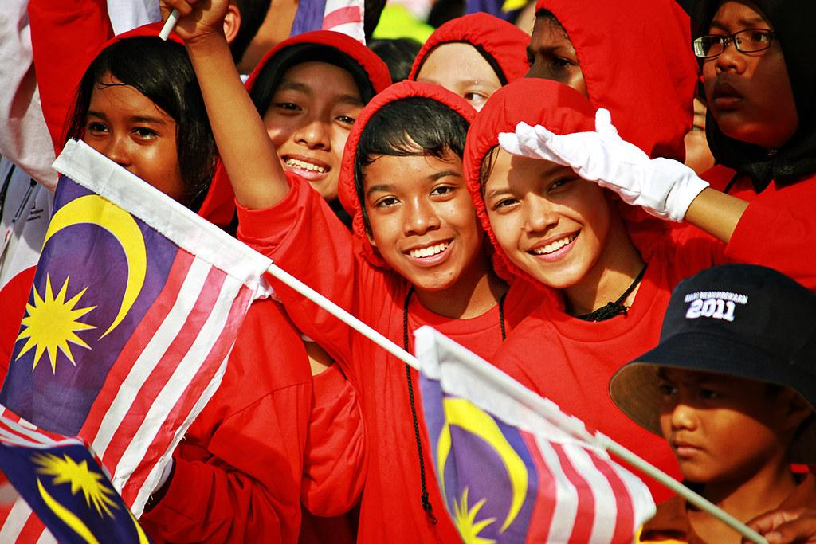
Social Structure
Malaysia is more of a collective society (Family, Business, etc.)
High Acceptance of a social hierarchy (high power distance)
Focus on unity, loyalty, and respect toward elderly/others
Malaysian follow Budi meaning prescription of oneself to others, while upholding peace and harmony
Femininity factors are more high in Malaysia relationships/selflessness is valued more than money/wealth
Khanh Nguyen (Blue Eyes Intelligence Engineering & Sciences Publication, 2019)
Notes:
Khanh

Slide 16
Business Culture in Malaysia
Workplace is organized in a hierarchy, meaning age and position plays a heavy role.
Personal relationships are a key factor in Malaysian businesses, since trust is a big part to success in the workplace.
Keeping a calm temperament in the workplace.
A consideration of someone emotional state is a must when involving someone work on a business venture.
Khanh Nguyen (Nina Evason, 2021), (Chara Scroope 2020),
Notes:
Khanh

Slide 17
Business and Cultural Etiquette
Formal clothing with western style is typical preferred in the workplace
Typical 9am-5pm (Monday-Friday) work day
Business cards are expected to be given when meeting new associates using your right hand supported by your left
Greeting toward each other in the workplace tend to be a handshake or a slight head nod
Expected to be on time to business meeting, but the first few minutes are spent on small talk and personal digression
Sensitivity and diplomacy should be considered when doing any type of work that involves others
Khanh Nguyen (Expat Arrivals 2024)
Notes:
Khanh

Slide 18
04
Political Environment

Slide 19
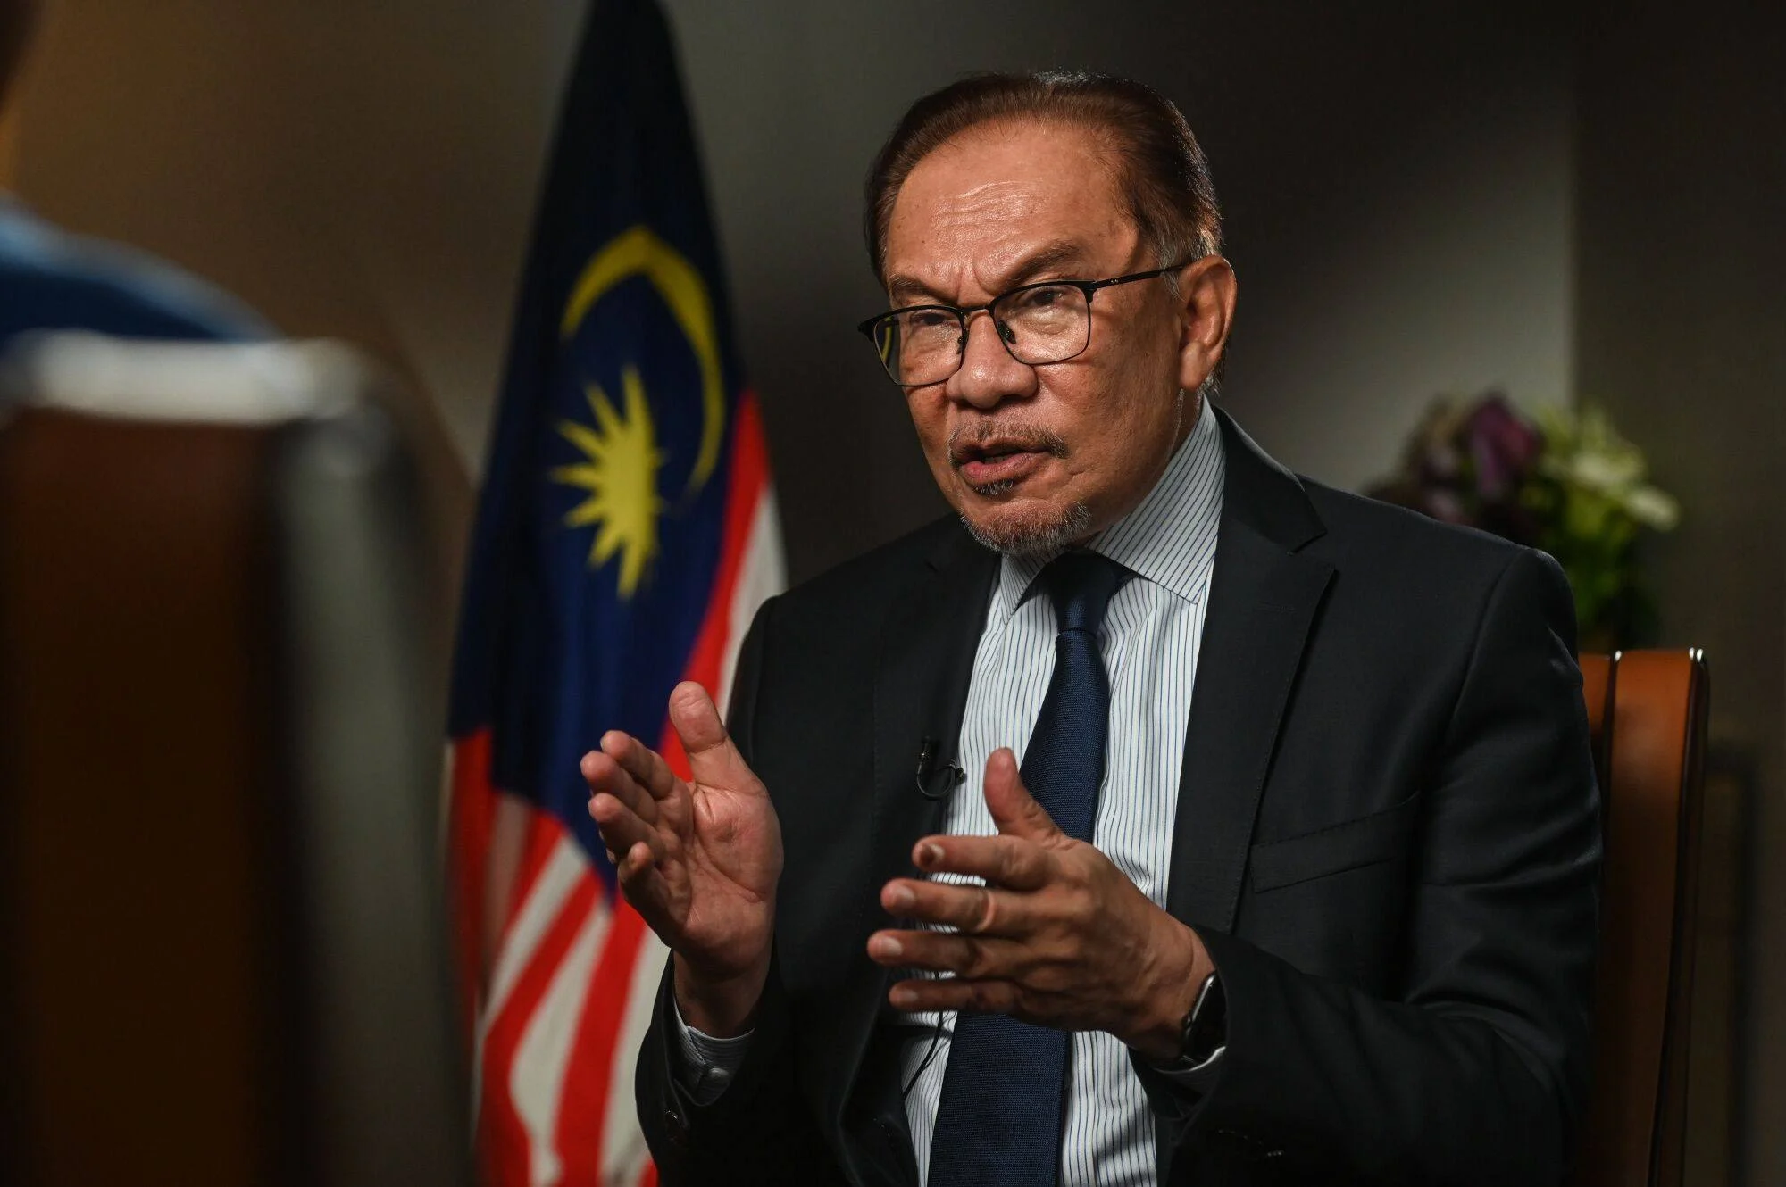
Democratic or Autocratic
Malaysia is a democracy
With a constitutional monarch
Independence: August 31, 1957
Branches of government
Executive, Judiciary, Legislative
Anwar Ibrahim - 10th Prime Minister
Appointed November 24, 2022
5 year term
Samuel Pak, Jasmin Lall, Amy Mei (South China Morning Post, )
Notes:
https://www.parlimen.gov.my/yda-maklumat-umum.html?uweb=yg&lang=en
https://www.parlimen.gov.my/yda-maklumat-umum.html?uweb=yg&lang=en
** Add more structure (

Slide 20
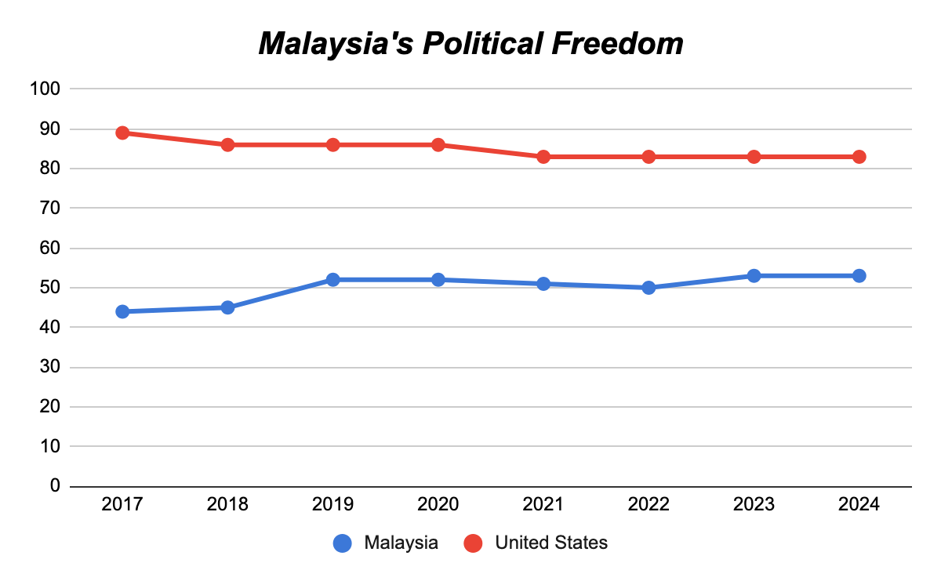
Political Freedom
Malaysia has a score of 53/100 as of 2024 (Rank: 115/210)
It is Partly Free
Compared to the US, which is 83/100 (Rank: 59/210)
Samuel Pak, Jasmin Lall (Freedom House, 2023)
Notes:
https://freedomhouse.org/country/malaysia/freedom-world/2021
** Add ranking as well

Slide 21
Political Unrest
Samuel Pak, Jasmin Lall (Human Rights Watch, 2022 // Freedom House, 2024)
During previous Prime Minister Ismail Sabri Yaakob (August 2021):
Aggressive crackdown on Freedom speech and peaceful protests
Harassing, intimidating and arresting activists & critics of the government
Discrimination against LGBT
Convicted of charges related to embezzlement (Billion $)
General election held in November resulted in division between several multi party coalitions.

Slide 22
Legal System
Samuel Pak, Jasmin Lall (Britannica, 2024 // Freedom House, 2023)
Mixed System consisting of:
English common law and Islamic law (Sharia)
Customary law
Judicial review of legislative acts in the Federal Court at request of supreme head of the federation

Slide 23
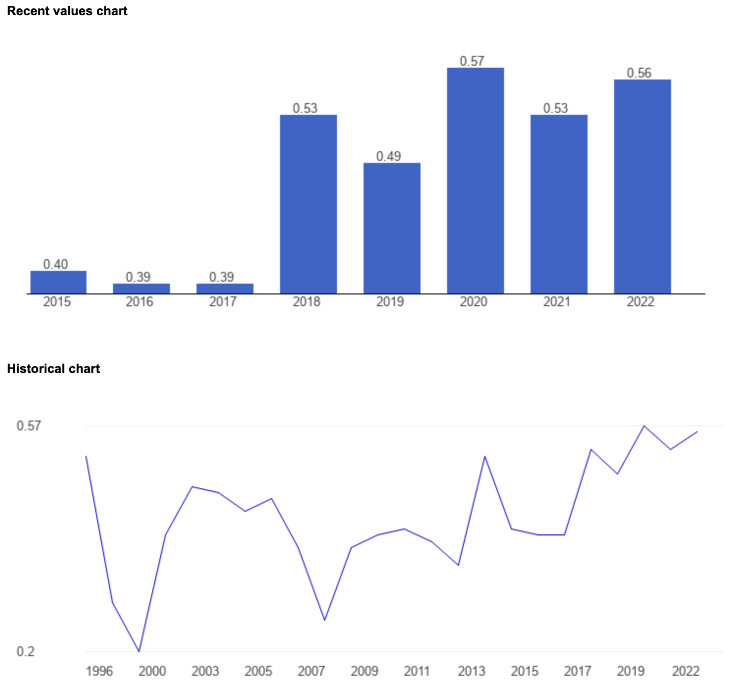
Rule of Man vs Rule of Law
Rule of Law Index (-2.5 weak ; 2.5 strong)
The average value for Malaysia during the period of 1996 to 2021 was 0.42 points with a minimum of 0.2 points in 1999 and a maximum of 0.57 points in 2020. The latest value from 2022 is 0.56 points.
2022 World Justice Project (WJP) Malaysia Ranks 55 out of 142 countries worldwide in Rule of Law Index.
US which is 26 out of 142.
Samuel Pak, Jasmin Lall (The Global Economy, 2022 and World Justice Project, 2023))
Notes:
https://www.theglobaleconomy.com/Malaysia/

Slide 24
Corruption Perception Index
MLAS Score: 50/100, Rank: 57/180 (2023)
US’s Score: 69/100, Rank: 24/180 (2023)
“0” (highly corrupt) to “100” (very clean)
+3 score change since 2022
0 score change since 2022
Samuel Pak, Jasmin Lall (Transparency International 2023)
Notes:
Malaysia’s Corruption Perceptions Index
How it’s calculated

Slide 25
05
Economic Environment

Slide 26
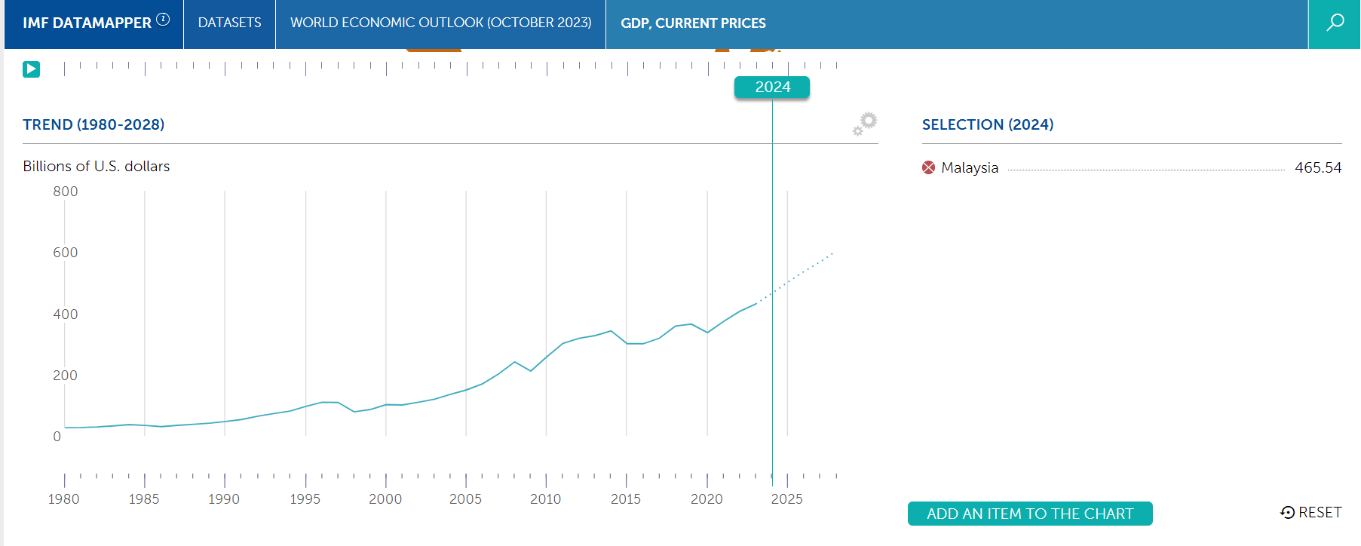
Economics
Mixed economy
Real GDP= 430.5 billions of dollars (2023 est)
Compared to the US=26.95 thousand billions of dollar (2023 est)
Real GDP growth rate = 3.8% growth and expected to be 465.54
Agricultural sector: palm oil, rubber, cocoa, wood products, rice and tropical fruits
Second largest palm oil producer and exporter after Indonesia
Poultry are also relatively strong in terms of export
Tourism is one of the biggest growing industries
Kelvin Thit, Amy Mei (International Monetary Fund, 2023)
Notes:
Amy

Slide 27
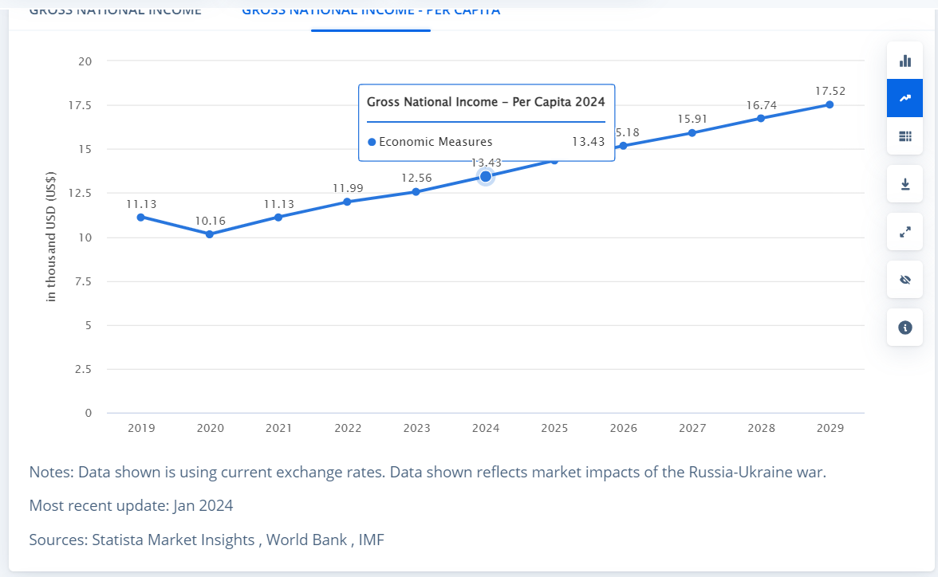
Income Per Capita
Kelvin Thit, Amy Mei (Statista 2023)
GNI per capita= 12.56 thousand USD (2023 est)
Higher compared to most of their neighboring countries and ASEAN countries
Average of 6590 MYR (Ringgit) which is about $1485 per month
Notes:
Kelvin

Slide 28
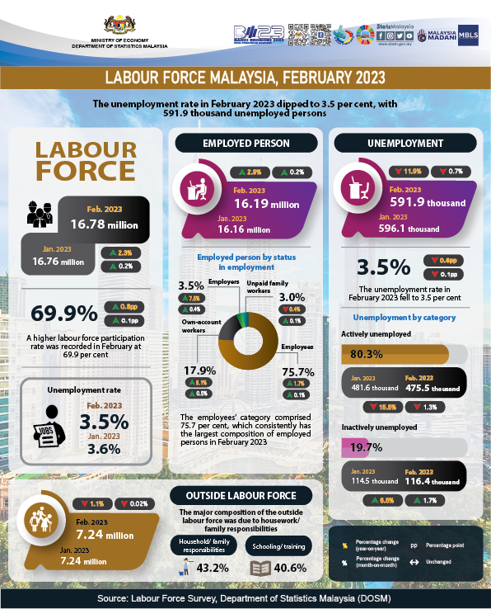
Kelvin Thit(DOSM, 2023)
Reported by DOSM (Department of Statistics Malaysia
Labour Force Malaysia, 2023 - Department of Statistics Malaysia
Key Takeaway
Growth in employment and participation in the workforce
More job opportunities due to the growth of tourism industry and agriculture industries
Notes:
Kelvin

Slide 29
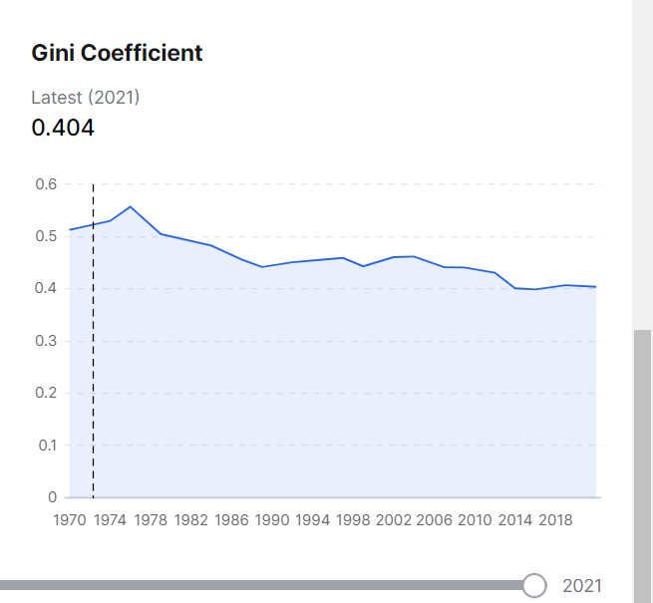
Income Distribution
GINI Coefficient of 0.404 as of 2021 but expected to be lower as of 2024 (0.39)
Majority of the people who are in poverty are from rural areas and less developed areas of Malaysia and is shown below
Compared to U.S (0.47), Malaysia’s GINI Coefficient is lower
Kelvin Thit(DOSM,2021)
Notes:
0 is true equality while closer to 1 is inequality Kelvin

Slide 30
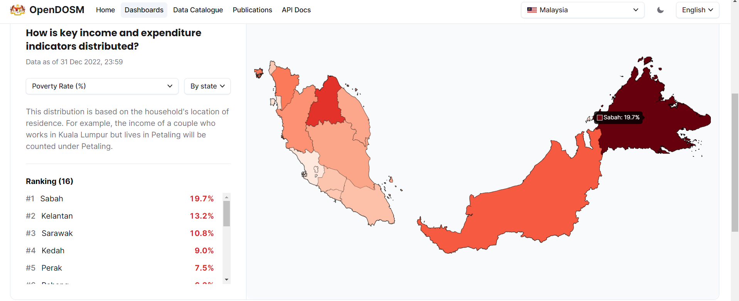
The darker the red, the higher the poverty rate
Sebah could be seen as the highest poverty rate because of its underdeveloped infrastructure
Rural area and no access to electricity and clean water
Kelvin(OpenDOSM, 2022)
Notes:
Kelvin

Slide 31
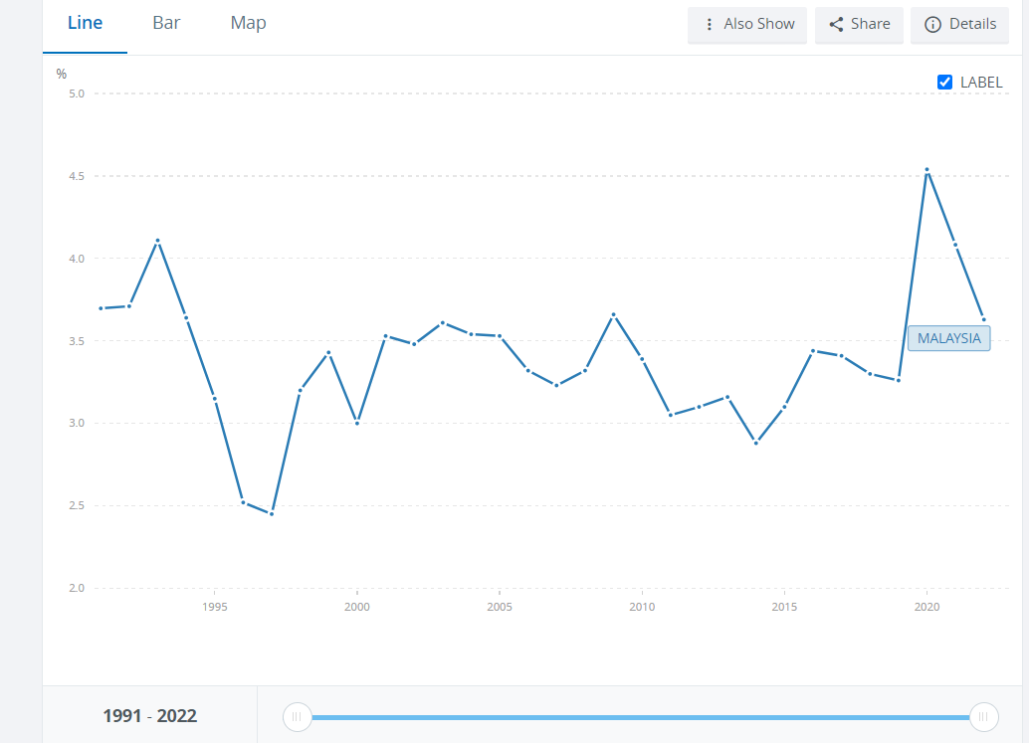
Unemployment
The unemployment rate as of 2022 in Malaysia was about 3.6-3.7 %.
Compared to this, US has the rate of 3.5% for 2022
However, Malaysia has made improvements in unemployment rate
Based on the graph above, we can clearly see that the unemployment rate has dropped to 3.5%
One of the main reason is that the government has been promoting incentives for job searches specifically for 40+ years
Introduced the 2023 Madani Career Initiatives, which include the Daya Kerjaya programme and the Bina Kerjaya programme
Kelvin Thit (The World Bank,2022)
Notes:
The Daya Kerjaya programme offers financial incentives to employers who hire long-term unemployed youth, women, persons with disabilities, indigenous people of Malaysia (Orang Asli), vocational training graduates, parolees, former convicts, and those from poor backgrounds.
Employers who participate in the Daya Kerjaya programme will receive financial incentives of RM600 (US$136) per month for a duration of three months, starting from the date of hire. The incentives will be applicable for new hires from 1 January 2023, and applications for the incentives can be submitted by employers beginning 1 April 2023.
Kelvin

Slide 32
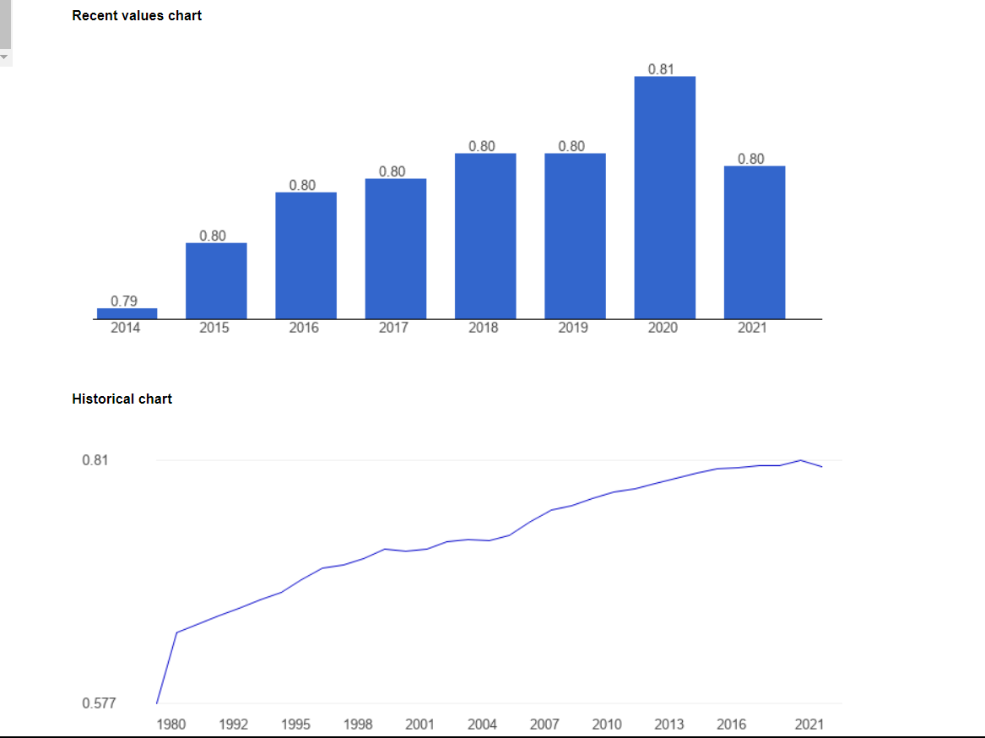
Human Development Index
Human Development Index of 0.803 in 2021
High relative to their ASEAN countries
The countries in the region with higher HDI are Singapore and Taiwan
Ranked top 18th in Asia (2021)
U.S average was 0.92 in 2021
HDI>0.8 is considered to be high
Kelvin Thit(The Global Economy 2021)
Notes:
Kelvin

Slide 33
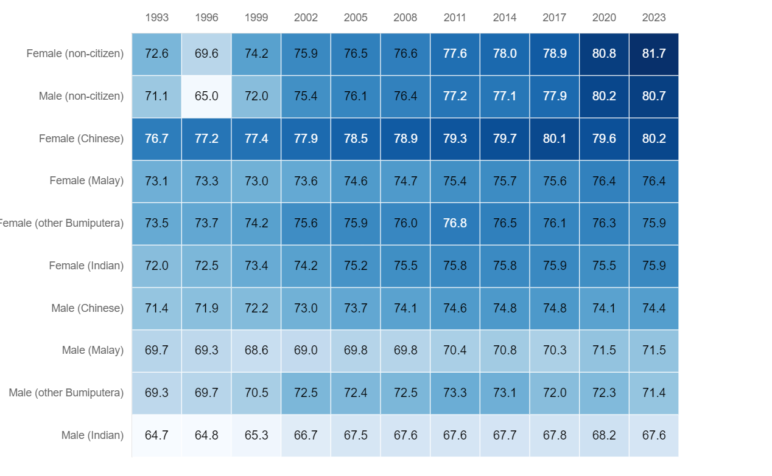
Average Life Expectancy
Kelvin Thit,Amy (OpenDOSM,2023)
Average Life Expectancy= 73.8 years
Constant improvement can be seen throughout the years
Increase investment in medical institution and equipment ( increase of medical beds increasing from 55,952 in 2016 to 65,508 beds in 2020)
12th Malaysia plan (Ministry of Health)
Affordable living situation and food for citizens
However, Malaysian food tends to be greasy and high in fat
High heart diseases and obesity
Notes:
Amy (https://open.dosm.gov.my/dashboard/life-expectancy)
https://www.ncbi.nlm.nih.gov/books/NBK54027/

Slide 34
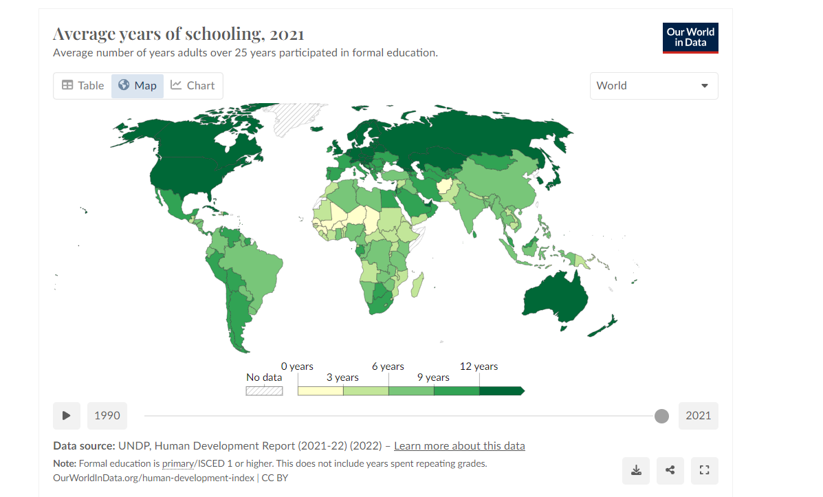
Education
Kelvin Thit (The Global Economy,2021) (Population Data,2021)
Malaysia
United States
Average year of education is 10.6 years (2021)
Spend about 4.5% of its GDP on education which is lower compared to their regional average (2018 est)
Unesco’s Institute of Statistics- 94.64% literacy rate (2021)
Average year of education is 13.7 years (2021)
Literacy rate for U.S in 2021 was 79% (National Center for Education statistics)
Immigration is one of the biggest factors for the lower rate of literacy rates for the U.S
Notes:
Kelvin

Slide 35
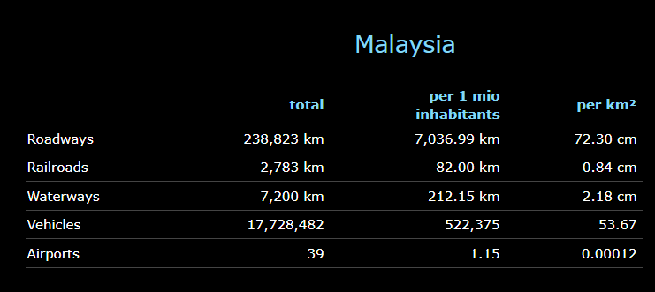
Infrastructure Challenges
Mentioned above, there are infrastructure challenges for Malaysia due to them still having various rural areas without access to electricity and clean water
Hard to attract potential investors and businesses
Digital divide (transparent during Covid-19)
Areas such as Sabah did not have the necessary communication and transportation regarding the resources and information
Ranked 62nd in the world for length of its rail networks (2020 est)
Lower compared to other Asian countries
USA-ranked 13th
Kelvin Thit (WorldData,2020)
Notes:
Kelvin

Slide 36
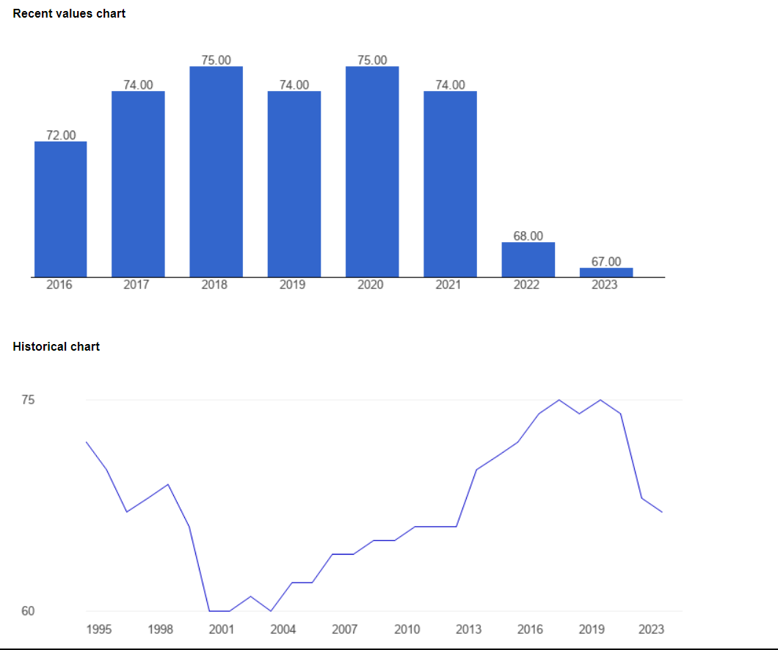
Economic Freedom
Downwards trend for Economic freedom and has a score of 67.00 as of 2023
One of the main factors that impact this is the high amount of corruption in the country
Even though they consider themselves as rule of law, there are various bribery from big corporations
Scandals such as the perceived special treatment to a former prime minister and his wife in 2020 on charges related to the multibillion-dollar 1Malaysia Development Berhad (1MDB) scandal stoked public outrage.
Regional rank:8 (2022) and World Rank:42
US-ranked 25th
Kelvin Thit(Statista,2023) (OpenDOSM,2023)
Notes:
Kelvin

Slide 37
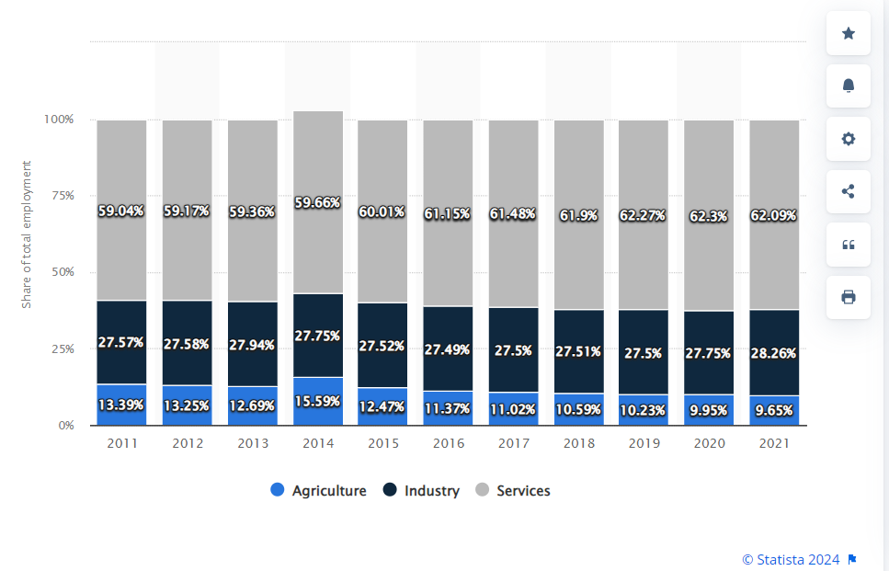
Distribution of Work Force
Kelvin Thit, Amy Mei(Statista,2021)
3 main categories: services, agriculture, and industry
Mentioned above, there is a labor force participation of 69.9% during 2023
Increase in industrial sector due to their trades with ASEAN countries and having a large amount of raw materials
Invest heavily in industry sector due to their palm oil and rubber production
Notes:
Kelvin

Slide 38
Thank you
Do you have any questions?
Please keep this slide for attribution

Slide 39
06
References

Slide 40
References
https://www.reuters.com/technology/sony-plans-smartphone-sensor-factory-japan-nikkei-2022-12-15/
https://www.sony.com/en/SonyInfo/CorporateInfo/History/company/
https://www.sony.com/en/SonyInfo/CorporateInfo/History/
https://www.sony.com/en/SonyInfo/products/
https://www.forbes.com/companies/sony/?sh=164958666f42
https://www.twice.com/retailing/sony-phasing-out-its-retail-stores-56291#:~:text=Beverly%20Hills%2C%20Calif.,Sony%20Experience%20in%2Dstore%20shops.
Culture
https://www.hofstede-insights.com/country-comparison-tool?countries=brazil%2Cegypt%2Cmalaysia%2Cunited+states
https://habib.camden.rutgers.edu/islam/kuala-lumpur/
https://www.statista.com/statistics/594657/religious-affiliation-in-malaysia/
https://culturalatlas.sbs.com.au/malaysian-culture/malaysian-culture-family
https://ling-app.com/ms/languages-spoken-in-malaysia/
https://www.familysearch.org/en/wiki/Malaysia_Languages
https://www.expatarrivals.com/asia-pacific/malaysia/doing-business-malaysia

Slide 41
References
Political Environment
https://freedomhouse.org/country/malaysia/freedom-world/2021
https://freedomhouse.org/country/malaysia/freedom-world/2023
https://www.brookings.edu/articles/democratization-on-hold-in-malaysia/
https://www.brookings.edu/articles/what-democracies-can-learn-from-malaysia/
https://www.cia.gov/the-world-factbook/countries/malaysia/#government
https://www.parlimen.gov.my/yda-maklumat-umum.html?uweb=yg&lang=en
https://www.transparency.org/en/cpi/2023/index/mys
https://www.transparency.org/en/news/how-cpi-scores-are-calculated
https://www.theglobaleconomy.com/Malaysia/
https://www.theglobaleconomy.com/USA/
https://worldjusticeproject.org/rule-of-law-index/global/2023/Malaysia/
https://www.youtube.com/watch?v=cB_awG3qXdk

Slide 42
References
Economics
https://www.imf.org/external/datamapper/profile/MYS
https://www.trade.gov/country-commercial-guides/malaysia-agricultural-sector#:~:text=Palm%20oil%2C%20rubber%2C%20cocoa%2C,producer%20and%20exporter%20after%20Indonesia.
https://data.worldbank.org/indicator/NY.GDP.PCAP.PP.CD?locations=MY
https://remotepad.com/countries/malaysia/average-salary/
https://open.dosm.gov.my/dashboard/household-income-expenditure
https://www.worlddata.info/asia/malaysia/transport.php
https://gain-new.crc.nd.edu/ranking/vulnerability/infrastructure
https://data.worldbank.org/indicator/SL.UEM.TOTL.ZS?end=2022&locations=MY&most_recent_value_desc=true&start=1991&view=chart
https://hrmasia.com/malaysia-launches-new-career-initiatives-to-boost-employment/
https://open.dosm.gov.my/dashboard/life-expectancy
https://themalaysianreserve.com/2023/11/07/upgrading-malaysias-hospital-capacity-with-lessons-from-pandemic/
/https://databankfiles.worldbank.org/public/ddpext_download/hci/HCI_2pager_MYS.pdf
https://themalaysianreserve.com/2023/08/08/malaysian-reading-habits-encouraging-but-more-must-be-done/
https://ourworldindata.org/grapher/average-years-of-schooling
/https://www.heritage.org/index/pdf/2022/countries/2022_IndexofEconomicFreedom-Malaysia.pdf
https://www.theglobaleconomy.com/Malaysia/economic_freedom/#:~:text=Economic%20freedom%2C%20overall%20index%20(0%2D100)&text=The%20latest%20value%20from%202023,to%20compare%20trends%20over%20time.
https://www.reuters.com/world/asia-pacific/malaysias-ex-pm-najib-multi-billion-dollar-1mdb-scandal-2022-08-23/
https://www.statista.com/statistics/319036/employment-by-economic-sector-in-malaysia/#:~:text=The%20services%20sector%20dominated%20Malaysia's,to%20the%20ten%2Dyear%20average.
https://v1.dosm.gov.my/v1/index.php?r=column/cthemeByCat&cat=124&bul_id=R1hRY2d1aTFBZzY4ZExudStRMjgxZz09&menu_id=Tm8zcnRjdVRNWWlpWjRlbmtlaDk1UT09

Slide 43
Opportunities
Brazil ICT Market Size, Share & Trends Analysis Report Forecast 2026 (globaldata.com)
Brazil - ICT - Information and Communications Technologies, and Telecommunication (trade.gov)\
Worldwide Tax Summaries Online (pwc.com)
https://www.reuters.com/article/idUSL8N15U3CD/
https://www.somo.nl/wp-content/uploads/2018/01/Labour-conditions-at-foreign-electronics-manufacturing-companies-in-Brazil.pdf
https://ecommercedb.com/markets/br/electronics
https://www.mordorintelligence.com/industry-reports/latin-america-consumer-electronics-market
https://www.statista.com/outlook/cmo/consumer-electronics/brazil
https://www.statista.com/outlook/cmo/consumer-electronics/brazil#:~:text=In%202024%2C%20the%20revenue%20in,amounts%20to%20US%2435.5bn.
Egypt ICT Market Size and Forecast (by IT Solution Area, Size Band and Vertical) to 2027 (globaldata.com)
Egypt - Corporate - Taxes on corporate income (pwc.com)
https://www.mondaq.com/employee-rights-labour-relations/1220872/the-main-provisions-of-the-labor-law-in-egypt
https://www.trade.gov/country-commercial-guides/egypt-information-and-communications-technology-and-digital-economy
https://ecommercedb.com/markets/eg/electronics
https://www.statista.com/outlook/cmo/consumer-electronics/egypt
https://ecommercedb.com/markets/eg/consumer-electronics
Malaysia ICT Market Size (mordorintelligence.com)
Malaysia - Corporate - Taxes on corporate income (pwc.com)
https://www.lexisnexis.com/blogs/gb/b/compliance-risk-due-diligence/posts/modern-day-slavery-widespread-in-malaysia-s-electronics-industry#:~:text=The%20two%2Dyear%20study%20of,a%20condition%20of%20forced%20labor.
https://eastasiaforum.org/2023/12/22/malaysias-semiconductor-industry-demands-a-more-strategic-outlook/
https://www.tradingview.com/markets/stocks-malaysia/sectorandindustry-sector/electronic-technology/
https://www.statista.com/outlook/emo/electronics/malaysia#revenue
https://ecommercedb.com/markets/my/electronics
https://eastasiaforum.org/2023/12/22/malaysias-semiconductor-industry-demands-a-more-strategic-outlook/
https://www.healyconsultants.com/brazil-company-registration/setup-llc/#:~:text=In%20accordance%20with%20Brazil%20corporate,and%20receive%20income%20from%20customers.
Foreign Company Registration Options in Malaysia | Acclime Malaysia
Egypt lifts the Egyptian ownership requirement for importation for commercial trading - Baker McKenzie InsightPlus
Understanding labor and employment laws in Brazil | Skuad
Work conditions in Egypt - International Trade Portal (lloydsbanktrade.com)
UN: 30% of foreign domestic workers in Malaysia face exploitative conditions — BenarNews

Slide 44
Market Penetration Grid References
Egypt Political
31. https://www.britannica.com/place/Egypt/Government-and-society
32. https://www.hrw.org/world-report/2021/country-chapters/egypt
Egypt Foreign Exchange Problems
30. https://www.trade.gov/market-intelligence/egypts-foreign-currency-crisis
22. https://www.privacyshield.gov/ps/article?id=Egypt-Foreign-Exchange-Controls
Egypt Business Laws
31. https://idai.pantheonsorbonne.fr/sites/default/files/inline-files/IDAI-L3-S2-Partie%20I.pdf
24. https://www.trade.gov/country-commercial-guides/egypt-market-entry-strategy
25. https://www.todaytranslations.com/consultancy-services/business-culture-and-etiquette/doing-business-in-egypt/
Egypt Natural Disasters
26. https://www.unisdr.org/2005/mdgs-drr/national-reports/Egypt-report.pdf
27. https://climateknowledgeportal.worldbank.org/country/egypt/vulnerability
28. https://www.aljazeera.com/news/2023/9/14/the-egyptian-village-that-lost-nearly-100-men-in-the-libya-floods

Slide 45
Market Penetration Grid References
Malaysia Political
29. https://www.britannica.com/place/Malaysia/Local-government#ref52545
30. https://freedomhouse.org/country/malaysia/freedom-world/2023
31. https://globaledge.msu.edu/countries/malaysia/government
32. https://www.gov.uk/government/publications/overseas-business-risk-malaysia/overseas-business-risk-malaysia
33. https://www.abc-amega.com/articles/country-risk-malaysia/
33. https://www.parlimen.gov.my/yda-maklumat-umum.html?uweb=yg&lang=en
Malaysia Foreign Exchange Problems
34. https://www.bis.org/publ/bppdf/bispap73p.pdf
35. https://asia.nikkei.com/Spotlight/Market-Spotlight/Malaysian-Thai-economies-suffer-as-currencies-slide-vs.-dollar
Malaysia Business Laws
36. https://www.nishimura.com/sites/default/files/images/110930_Malaysia_E.pdf
37..https://shinewingtyteoh.com/challenges-doing-business-malaysia#:~:text=Taxation%20Challenges%20and%20Incentives,incentives%20tailored%20to%20stimulate%20investment.
38. https://practiceguides.chambers.com/practice-guides/doing-business-in-2023/malaysia
Malaysia Natural Disasters
39. https://nidm.gov.in/easindia2014/err/pdf/country_profile/Malaysia.pdf
40. https://www.adrc.asia/nationinformation.php?NationCode=458&Lang=en&NationNum=16
41. https://www.unescap.org/sites/default/d8files/event-documents/Malaysia_7th_TWG_30Apr2021.pdf

Slide 46
Market Penetration Grid References
Brazil Political
42. https://www.chathamhouse.org/2022/08/democracy-brazil
43.https://clintonwhitehouse3.archives.gov/WH/New/SAmerica/brazil.html#:~:text=Political%20parties%3A%20Brazilian%20Democratic%20Movement,(PSB)%2C%20Communist%20Party%20of
44. https://www.europarl.europa.eu/RegData/etudes/ATAG/2015/559491/EPRS_ATA(2015)559491_EN.pdf
45. https://www.chathamhouse.org/2022/08/democracy-brazil
Brazil Foreign Exchange Problems
46. https://www.trade.gov/country-commercial-guides/brazil-market-challenges
47.https://www.trade.gov/country-commercial-guides/brazil-trade-agreements#:~:text=Brazil%20%2D%20Trade%20Agreements&text=Brazil%20is%20a%20member%20of,that%20issues%20and%20harmonizes%20standards.
48.https://www.state.gov/u-s-relations-with-brazil/#:~:text=As%20the%20largest%20democracies%20in,biodiversity%3B%20and%20strong%20defense%2C%20health
Brazil Business Laws
49. https://www.trade.gov/country-commercial-guides/brazil-market-challenges
50. https://uk.practicallaw.thomsonreuters.com/0-503-8385?transitionType=Default&contextData=(sc.Default)&firstPage=true
Brazil Natural Disasters
51.https://www.preventionweb.net/news/extreme-weather-and-climate-events-brazil#:~:text=Extreme%20rainfall%2C%20or%20lack%20thereof,%25%20of%20weather%2Drelated%20disasters.
52. https://climateknowledgeportal.worldbank.org/country/brazil/vulnerability

