Slide 1
New International Venture
By Khanh Nguyen, Jasmin Lall, Amy Mei, Kelvin Thit, Samuel Pak, Trevon Lofton
Notes:
Khanh

Slide 2
Table of Contents
02
IB Objectives
01
Group Introduction
03
Strategies
04
Country Specific Advantages
05
Country Specific Weaknesses
06
Firm Specific Advantages
07 Firm Specific Weaknesses
08
Marketing 4 P’s
09
Production and Supply Chain
10
References
Notes:
Khanh

Slide 3
01
Group Introductions

Slide 4
Group: Sony
Amy Mei | IB Objectives, Global Strategies
Jasmin Lall | Geographic Strategies, Proposed Intl. Entry Strategy
Trevon Lofton | Marketing 4 P’s
Kelvin Thit | Country Specific Advantages, CSA/FSA Matrix
Khan Nguyen | Firm Specific Advantages
Samuel Pak | Production and Supply Chain

Slide 5
02
IB Objectives

Slide 6
Current IB Objective: Expand Sales
Current IB Objective for Sony is expand sales
Sony expands internationally by growing its global partner network
AV Alliance and Technology Network
Grow and improve business by building more relationships with companies around the world
Expansion can lead to new opportunities, increased sales, and greater reach for Sony on global scale
BRAVIA Professional Displays (Best Resolution Audio Visual Integrated Architecture)
Sony’s quarterly profit totaled 363.9 billion Yen or $2.4 billion USD in February 2024
Future plans for PlayStation to have more games and Mobile and Cloud Integration
Amy Mei
Notes:
#fix on going international

Slide 7
03
Strategies
Notes:
Move the strategies to the business objective (IB)

Slide 8
Geographic Strategies
Current Strategy:
Geographic Diversification
Sony quickly expanded into numerous countries after its establishment
Established headquarters in major cities around the world and built up from there
Initially established in Japan (1946)
Began expanding globally into:
United States (1960)
Europe - UK, France, Germany (1960s/70s)
China (1970s)
Proposed Strategy:
Geographic Concentration
Should conduct research understand how consumer preferences and overall market conditions differ among countries
Tailor products and services to suit consumer preferences based on region
For example, popular products in Malaysia include smartphones and laptops, so Sony should use this to their advantage
Sony could also focus on expanding in Australia; they have a presence here but stepped away due to wanting to focus on other countries
Jasmin Lall (Sony, Statista, GSMArena)
Notes:
https://open.sourcemap.com/maps/search/Sony
Identify other key countries that we want to go into and not necessarily need Malaysia
Geographic diversification or geographic concentration
Tell why select those countries

Slide 9
Current & Proposed Global Strategy:
Standardize
Exploitation of location economies, companies can achieve economies of scale by increasing production and lowering costs
Quality of products or services remain consistent and equivalent to other products in the same industry
Ensure compatibility; different components, systems, or software work together without conflicts
Do development and research then outsource the manufacturing in other countries that will allow cheap labor costs
Malaysian citizens are more likely to trust Sony as a brand because of their reputation
Sony is known for advanced technology, consumers know they can rely on its products
Sony products have great durability, effectiveness, and efficiency of which ultimately helps the company get more global recognition around the world
Amy Mei
Notes:
https://open.sourcemap.com/maps/search/Sony
Cannot standardize due to differentiation

Slide 10
Proposed International Entry Strategies
Initial: Joint Venture
Sony will benefit from partnering with a corporation such as Genting Berhad
a Malaysian parent corporation that specializes in a variety of businesses such as hospitality, gaming, entertainment, etc.
Begin by integrating their technology into resorts and casinos that are owned by Genting Berhad, as these fall under the leisure and hospitality categories
Genting Berhad has resorts and casinos both within Malaysia and internationally
Begin by integrating entertainment products such as TVs, cameras, and audio equipment since they are commonly used within these locations
Jasmin Lall
(Genting Berhad)
Notes:
https://open.sourcemap.com/maps/search/Sony
What are they going to do? Specific examples

Slide 11
Proposed International Entry Strategies
Long Term: Internal New Venture
Sony will utilize an internal new venture strategy to establish themselves independently in Malaysia
~5 years after initially entering Malaysia
Part ways with Genting Berhad, establishing their own independence
By this time, Sony will have an in-depth understanding on what Malaysian consumers are looking for, how to adapt their products to meet consumer needs, and will have established a recognizable brand presence, allowing them to venture off on their own
Jasmin Lall (Statista)
Notes:
https://open.sourcemap.com/maps/search/Sony

Slide 12
04
Country Specific Advantages

Slide 13
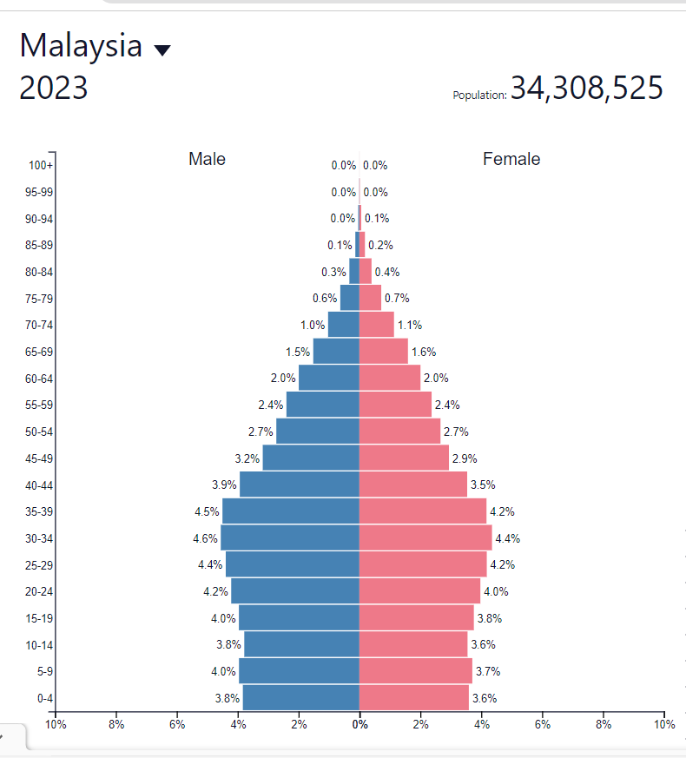
Young Population demographic
9.13 million, which makes up 27.4 percent of the population
There is a higher demand for technologies
Increased use of technology in Malaysia due to the increase in e-commerce, data analytics, and data centers
The National 4IR policy implemented which advocates for the use of technology from the social, economic, and environment perspective
Kelvin Thit (populationpyramid , privacy shield)

Slide 14
Stable Business Environment
New companies ACT (2016)
Makes processes easier for convenient/straightforward/ and cost effective
Exemption from audits for dormant companies, those generating no revenue, and companies meeting specified threshold criteria.
Removal of the obligation for an annual general meeting for companies in the private sector.
Simplified approval of written resolutions for private sector companies
Encourages international businesses by lowering corporate taxes when meeting certain requirements
Strategic location- maintains strong relationships with ASEAN countries
Kelvin Thit (Businessgo)

Slide 15
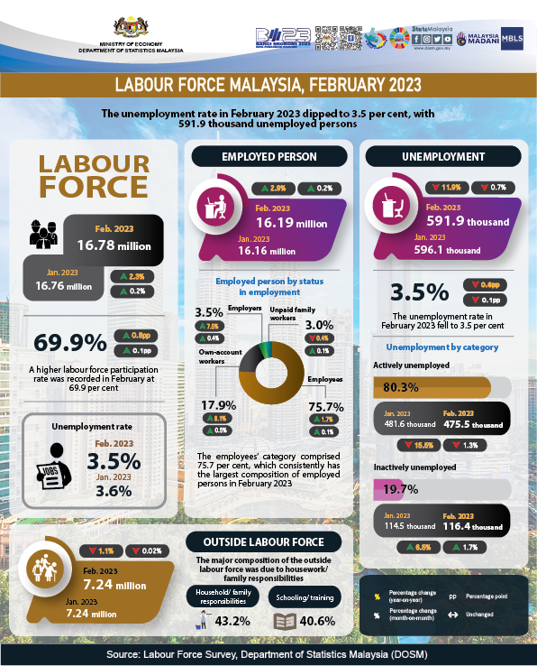
Labor Force and High Participation
69.9% of the population are involved in the labor force
Average education : 10.6 years
Adequate amount of skilled workers
More workers and the labor fees are lower compared to Europe and North America
Kelvin Thit(DOSM, 2023)

Slide 16
05
Country Specific Weaknesses

Slide 17
Competition/ Competitive Market
Competition against the likes of Intel and Dell
More choices for the consumers
Offer the Play Station which other companies are not offering
Kelvin Thit (Virtual Space)

Slide 18
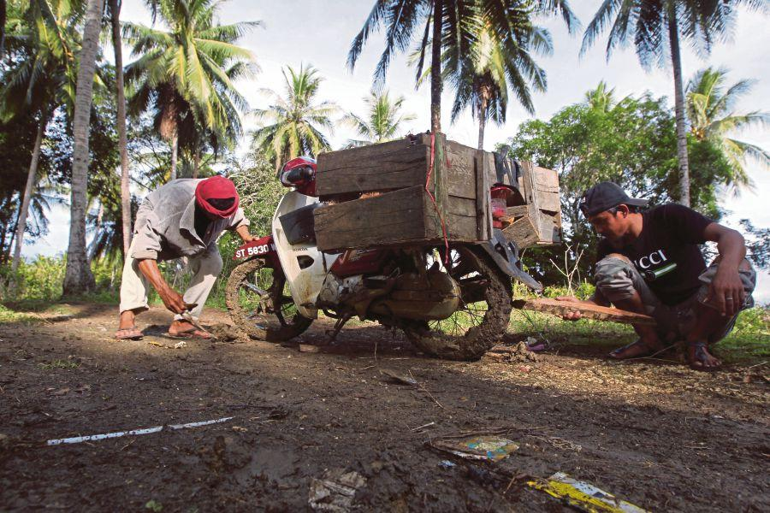
Infrastructure Struggles
Improving continuously, however there are still struggles in transportation and digital divide still exists
Ranked 62nd in the world for length of its rail networks (2020 est)
Rural areas do not have access to proper internet and companies would avoid such places
Concerns about transportation safety as it is an important factors for companies
Kelvin Thit (WorldData,2020)

Slide 19
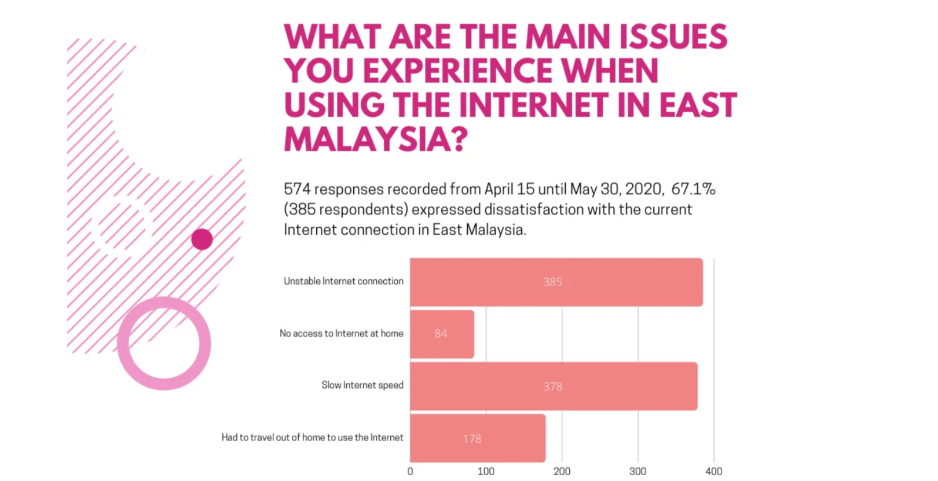
Internet Connection/Communication
Digital Divide especially in East Malaysia
Slow and unstable internet
Business monopoly by government-linked Internet service provider Telekom Malaysia
Implementing new plans for Sebah and Sarawak but it is going to take time (Sarawak digital economy plan and NFCP in Sebah)
Kelvin Thit (Medium)

Slide 20
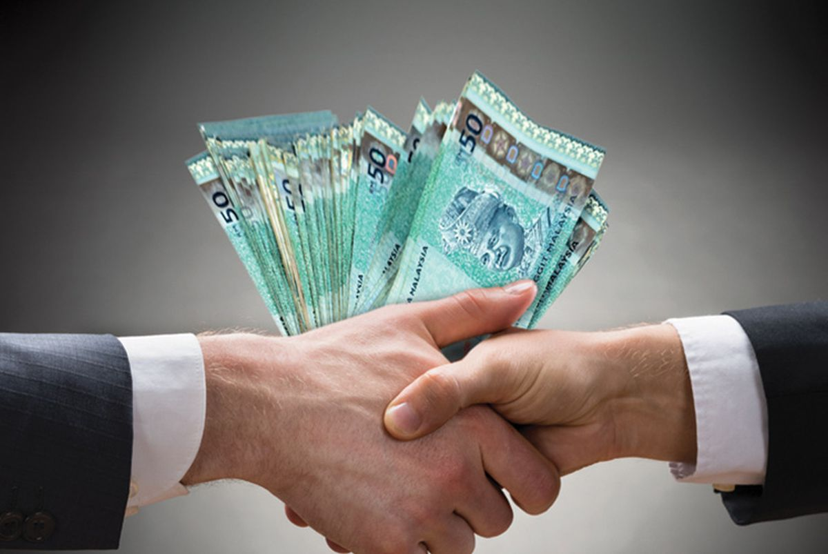
Corruption
Ranked 57th on the corruption index
Monopolies exist which is cooperated with the government which makes it hard a company in the same sector to enter.
Discourage investors and entrepreneurs
Fraud cases-1MDB
Kelvin Thit (Transparency, ojb)
Notes:
0 being no corruption and 100 being corrupted

Slide 21
06
Firm Specific Advantages

Slide 22
Brand Recognition
Khanh Nguyen (International Journal of Managerial Studies and Research 2015)
Sony didn’t want to be defined as a single product, but instead the enterprise of products they have built upon
From the beginning, the company wanted to have an independent brand identity instead of being familiarized with other enterprises
That is why an aim towards variety and global reach was focused on

Slide 23
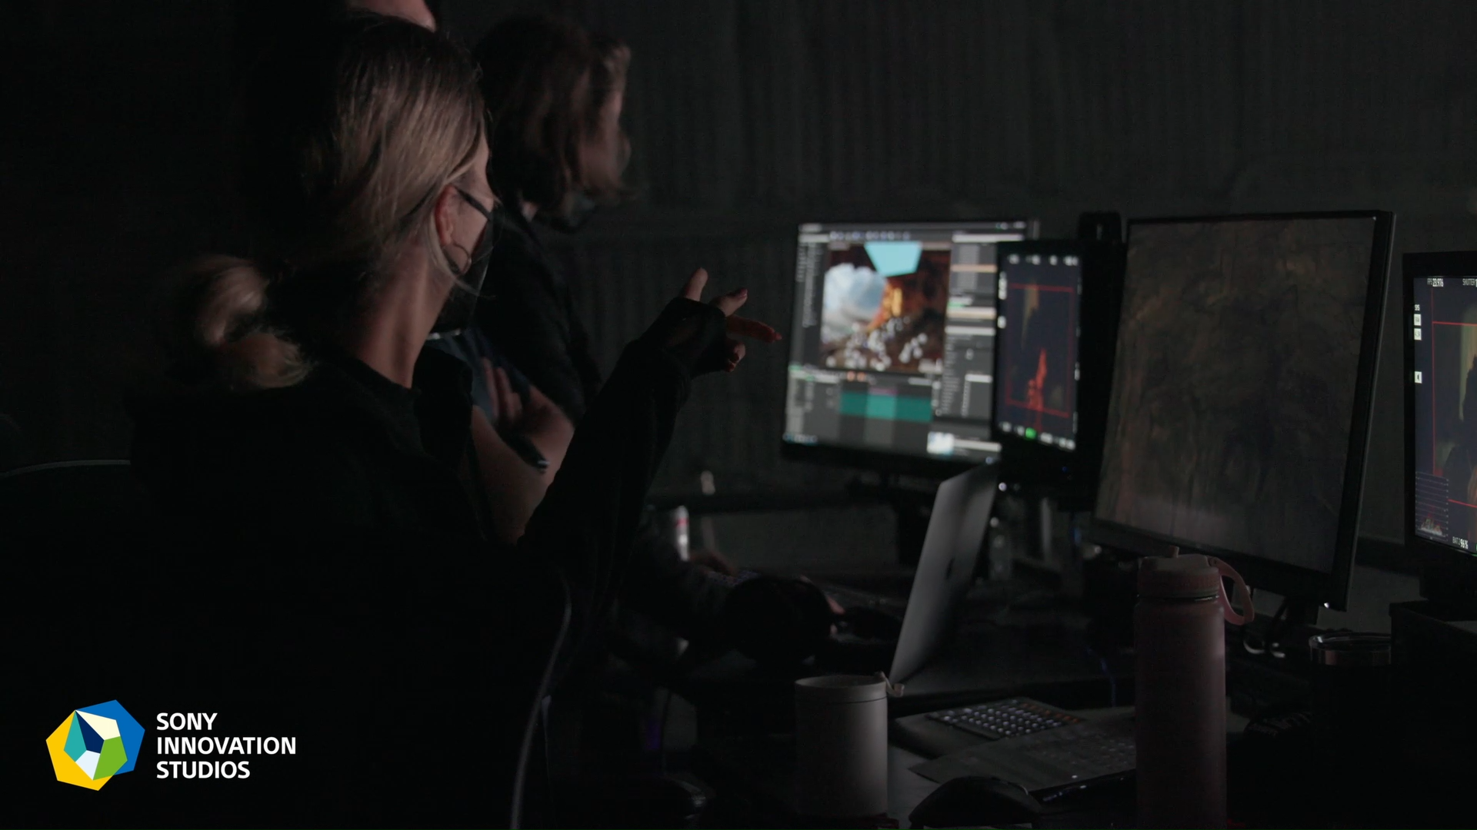
Technological Innovations and Revisions
Khanh Nguyen (International Journal of Managerial Studies and Research 2015)
Sony has always been on the forefront when it came to creating new technology for their vast catalogue of products
Offering in Music & pictures, digital entertainment, mobiles, and PC devices
This aspect gave Sony a way to do well in foreign markets, becoming a leader in exporting, later establishing themselves as producers in many countries.
Sony today, still invest a lot in coming up with new innovations that will help revolutionize all different types of industries

Slide 24
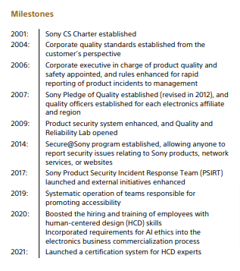
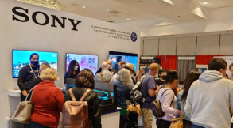
Quality and Customer Service
(Sony Sustainability Report 2022)
Sony constantly tries to deliver the best overall experience for its customers through constant taking in of feedback
The company believes that customers have the right of safety, security, and accessibility when it comes to their products
That is why many long term goals were set for the company to accomplish sustainable and reliable products

Slide 25
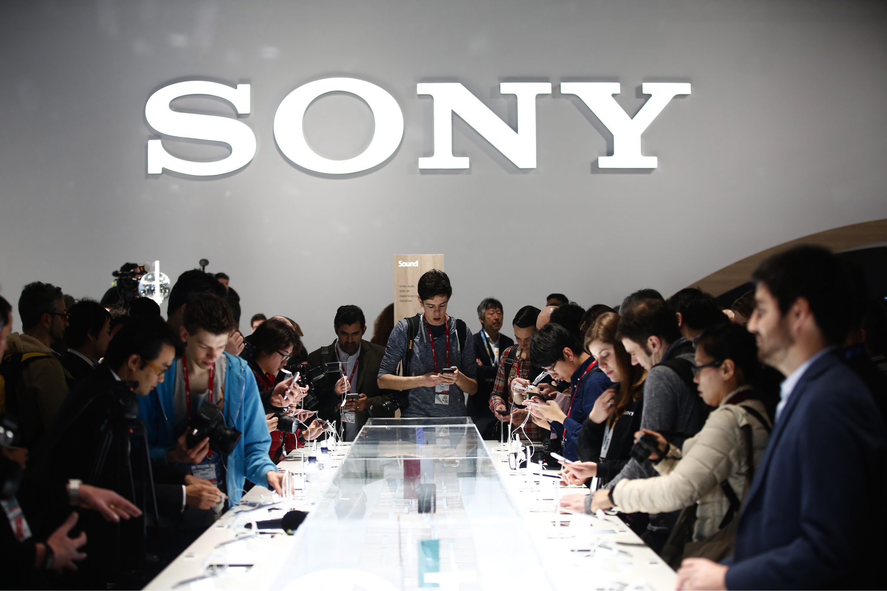
Foreign Business Experience
(Brianna Parker/Business Strategy Hub 2024) (Edubirdie 2022)
Sony long before its competitors, have been in the global market for some time now. Being major players in countries like the United States and Europe as early as the 1960s and 1970s, way before many of their competitors were even doing business
Having established a strong supply chain for market areas that may require different needs
Examples would be Sony’s playstation line, where there is less complexity to its supply chain. Compared to its innovative product manufacturing, which the company likes to keep more in its origin country

Slide 26
07
Firm Specific Weaknesses

Slide 27
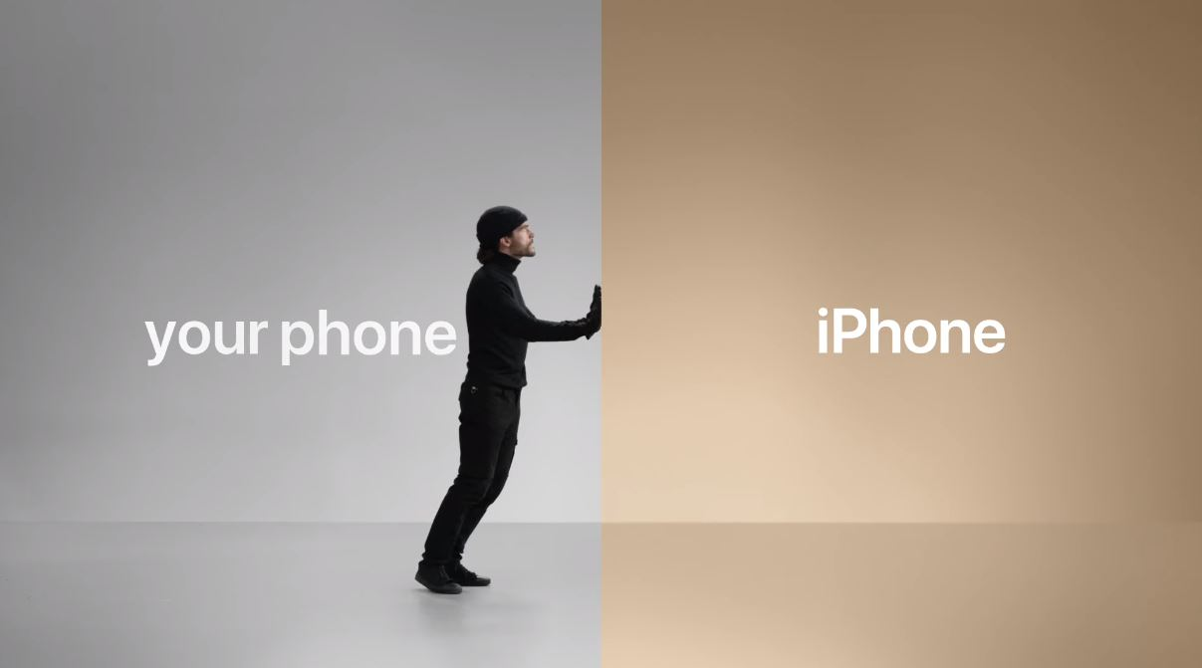
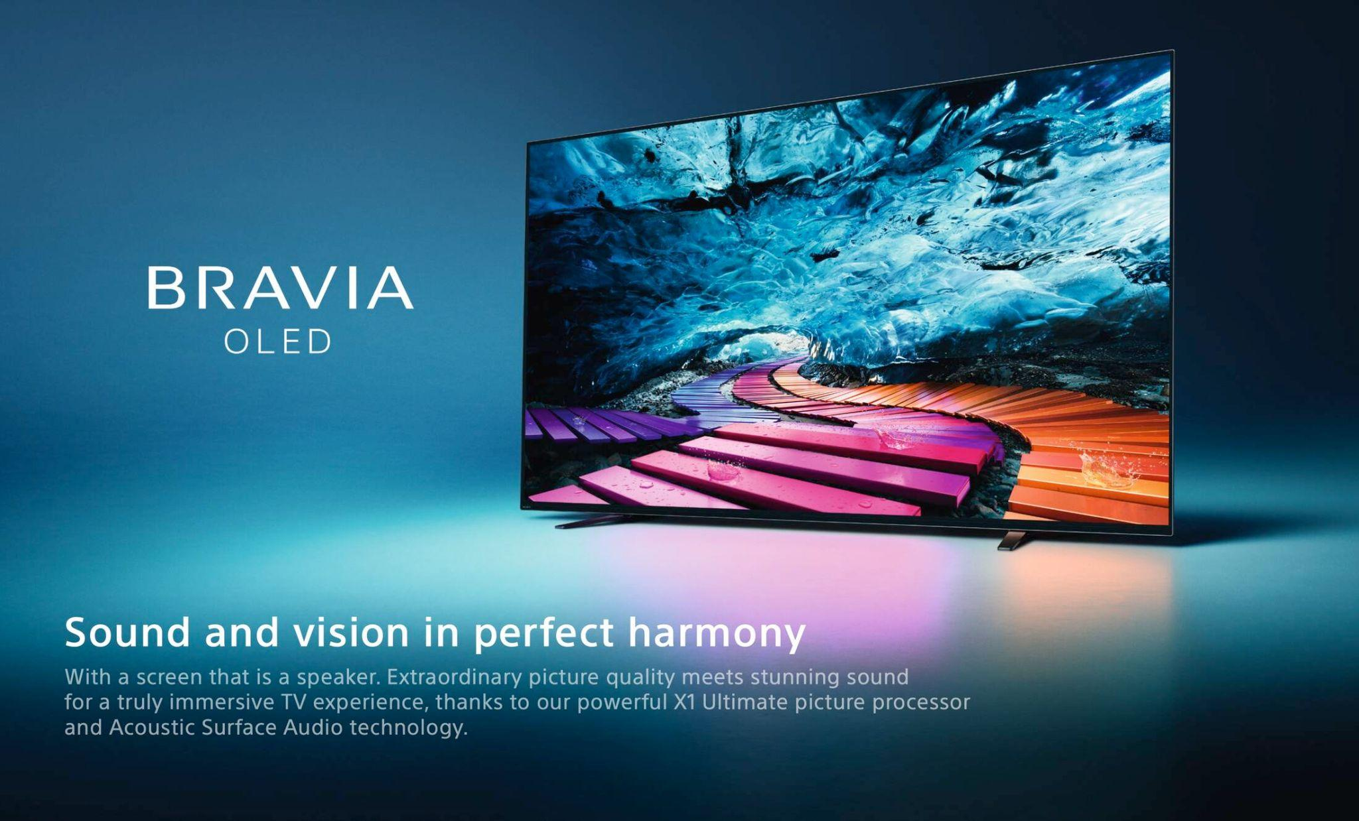
Sony Marketing Flaws
(Denise Harrison/Center for Simplified Strategic Planning 2013)
A struggle to focus on one business area has always been a problem for the company, causing conflicting goals when trying to accomplish a streamline view of the business
Sony may be the first when it comes to innovations and market entry but lacks marketing tactics that excites customers
This also plays into current Sony dominate markets, where keeping customer investment with the brand have been lackluster

Slide 28
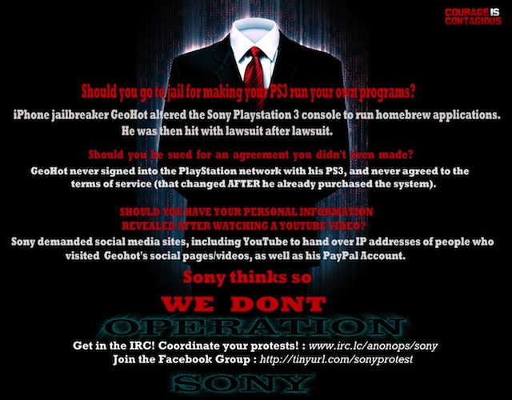
Negative Publicity and Security/Data Breaches
(Alex Bracetti/Complex 2011) (Trendmirco 2014)
Sony throughout the years have done certain things that weren’t so well perceive by the public
Advertisement like their PSP promotion and their 2014 movie The Interview had a mass amount of negative input from the public
The company also has dealt with many security breaches, like their 2011 Playstation network breach and 2014 Sony Picture data hack

Slide 29
CSA/FSA chart
 | Internal Weaknesses Marketing strategies (AP) (CFSSP) Negative publicity (2014 Sony Picture hack) (CPLX) (TR) Security and data breaches (CPLX) (TR) | Internal Strengths Brand Recognition (IJOM) Innovation (IJOM) Experienced in foreign business (BSH) (EB) Quality and Customer Service (SSR)
External Strengths Young population (higher demand for technology) (PP) (PS) Stable Business environment (BG) Labor force and high participation (DOSM) | Cost Leadership | 3. Cost Leadership or differentiator
External Weaknesses Infrastructure (WD) Competition(VS) Internet Connection/Communication (MD) Corruption (ojb,Tsp) | 2. Exit or Restructure | 4. Differentiation
Notes:
**MARKETING COMES AFTER THIS SLIDE**

Slide 30
08
Marketing 4 P’s
Trevon

Slide 31
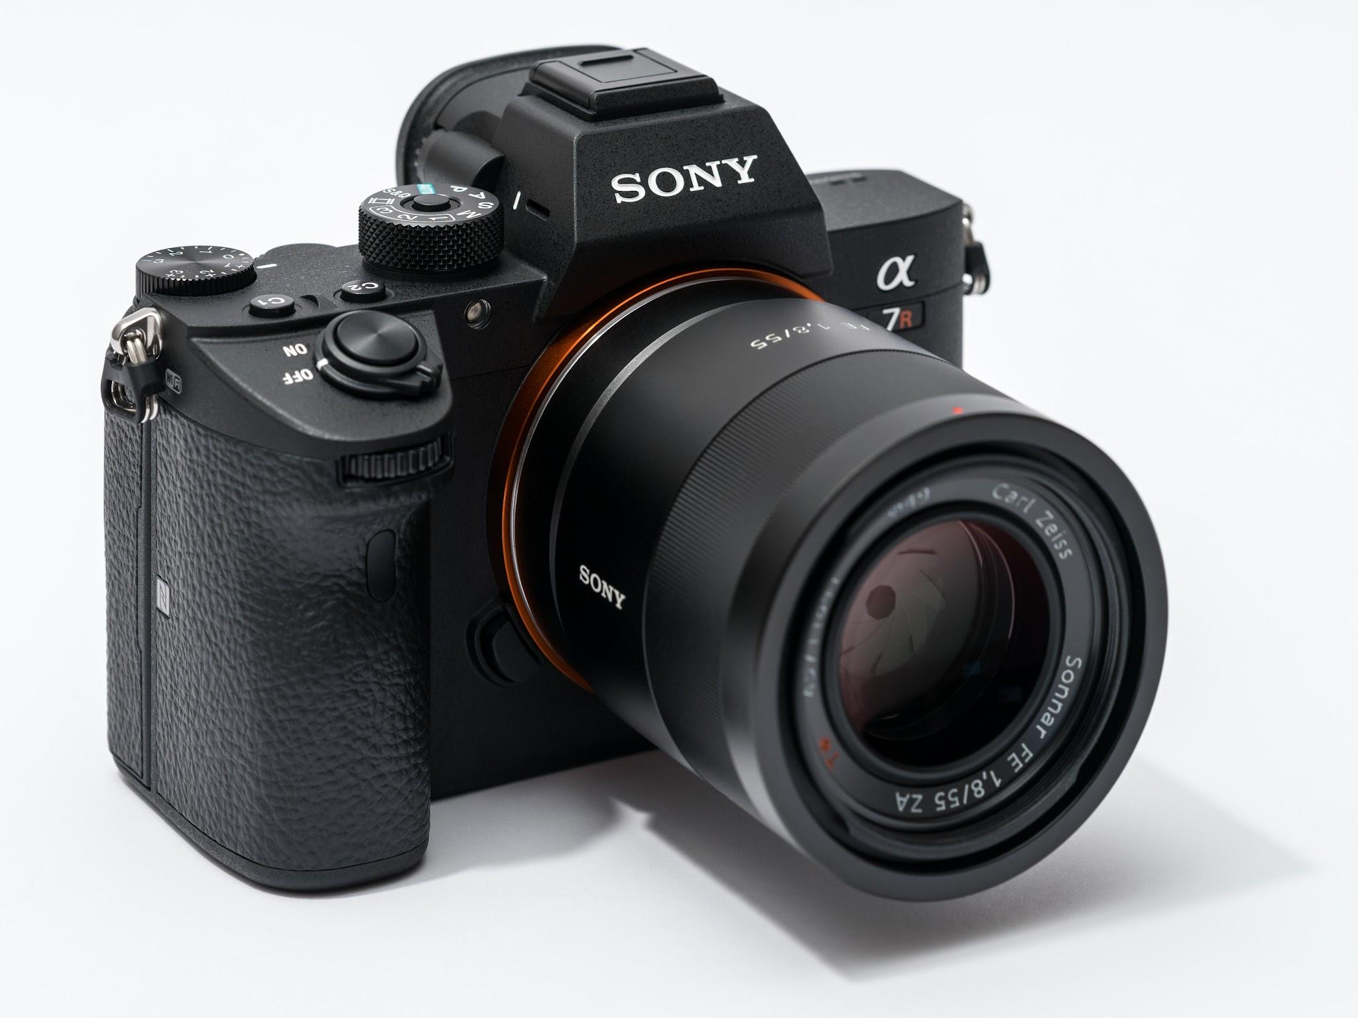
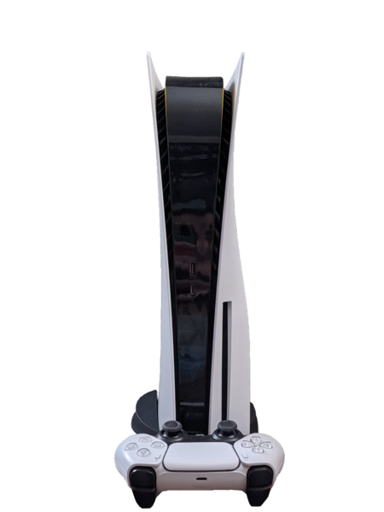
Product
Trevon (Statista)
Initial 1-3 years
Introduce commonly used household entertainment:
Smartphone, laptop, camera
Long term 4+ years
Introduce diverse product portfolio:
TV, household appliances, headphones

Slide 32
Place: Distribution
Trevon
Short term:
1-3 years
Cities:
Kuala Lumpur
Johor Bahru
Long term:
To expand to the major smaller cities and across to Kuching

Slide 33
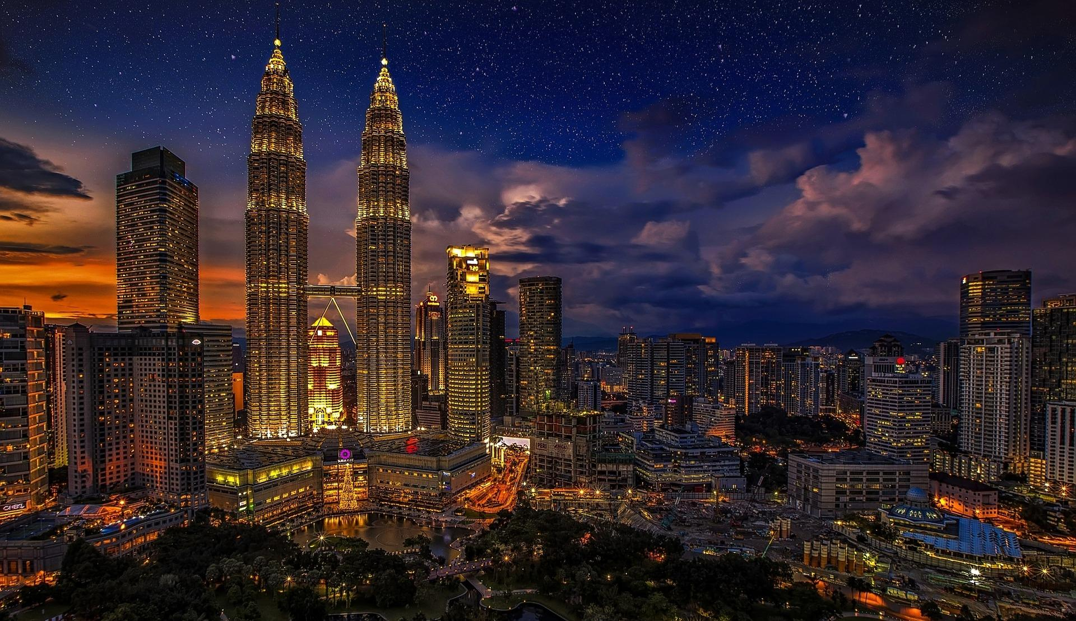
Place: Kuala Lumpur
Capital City of Malaysia
Most populated city in the State/Country
estimated population 8.6 million
Accounts for 16% of GDP
Economic growth averages of 6-7% per year
Trevon (unescap.org)

Slide 34
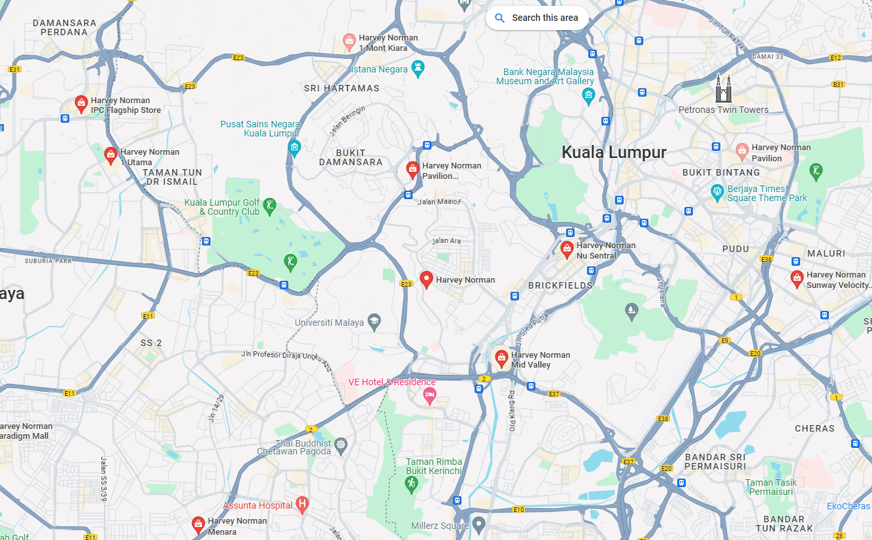
Place: Kuala Lumpur
Wealthiest city
Harvey Norman
26 stores in Malaysia
Top tourist attraction & shopping centers
Petronas Twin Towers
Trevon (harveynorman)

Slide 35
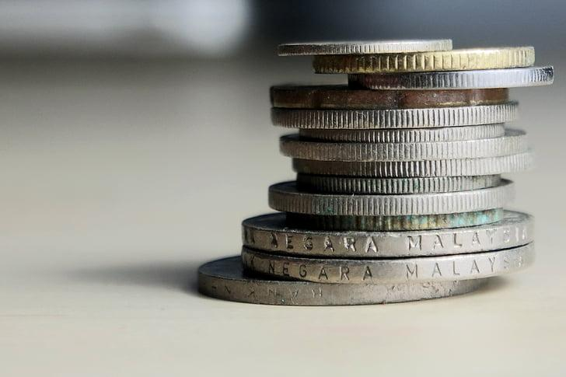
Price
Trevon (privacyshield.gov)
Skimming Strategy
Setting an initial high price for high quality products
Product or service is new or revolutionary to the market
Offer value, quality, innovation, customer service
Higher profit margin
Notes:
Cannot be the penetration strategy to match the CSA/FSA matrix
** Feedback: Skimming Strategy (pricing)

Slide 36
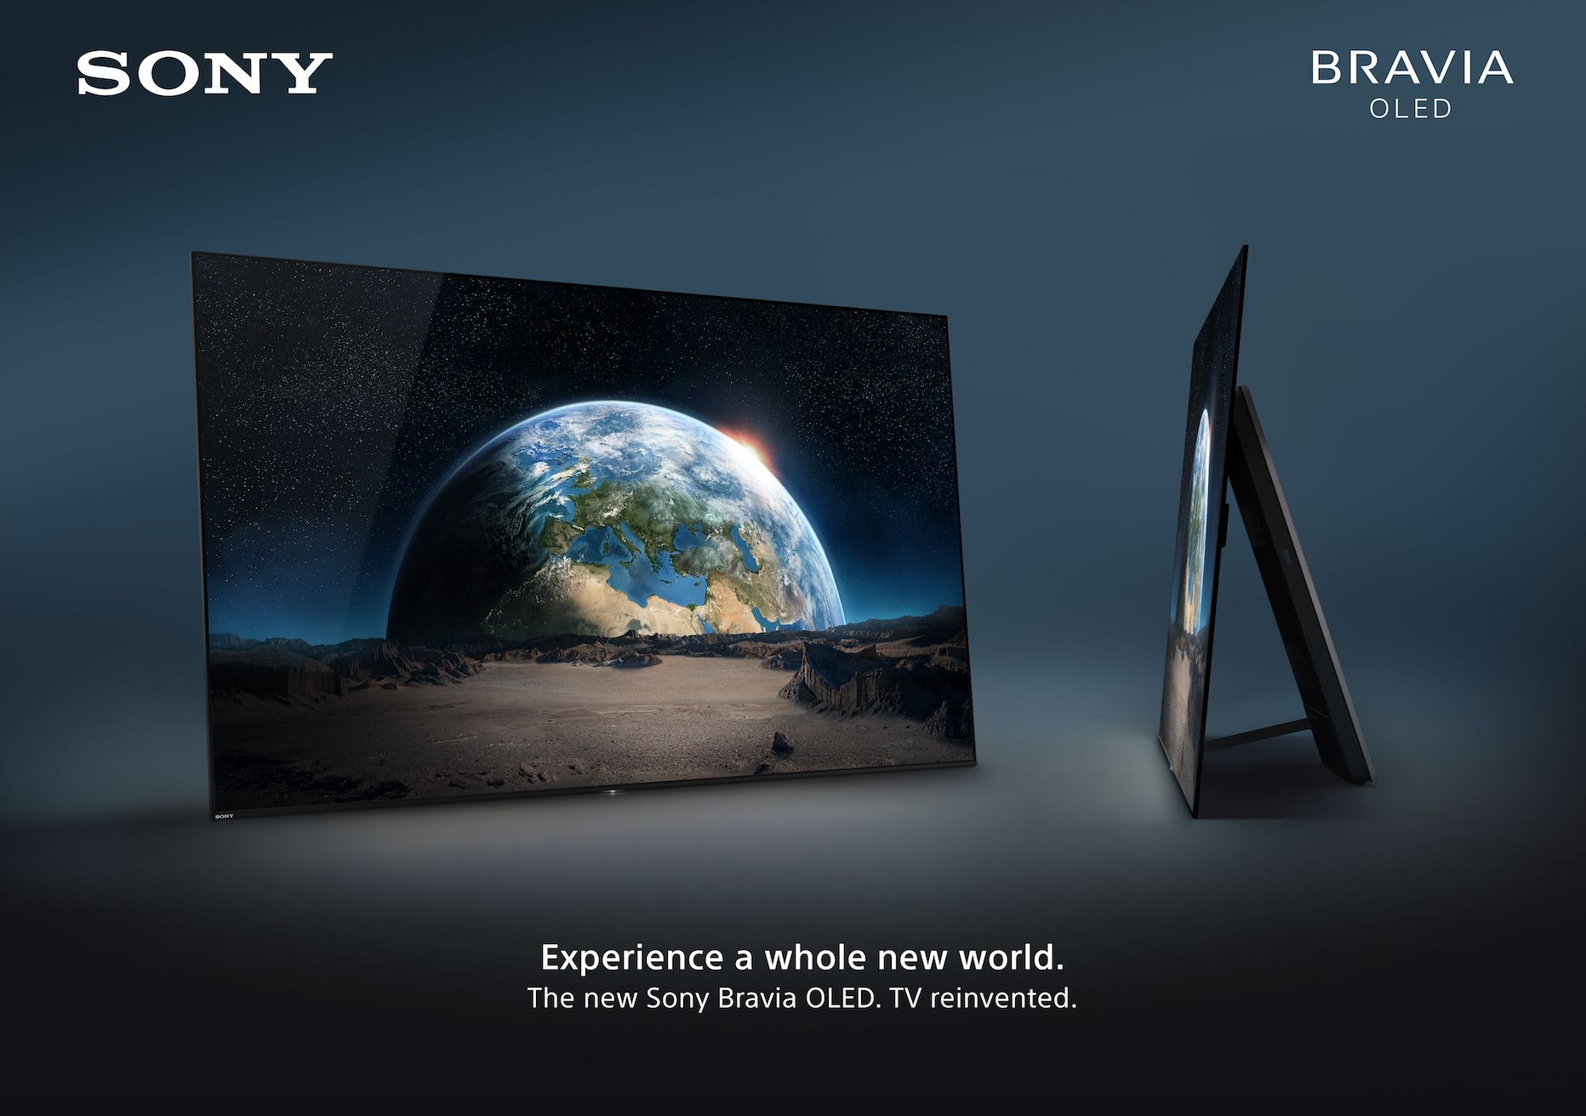
Promotion
Trevon (Sony)
Global Localization
Individual cultural
Legal
Regulatory necessities
Having local operations meet local needs whilst introducing common global concepts and technologies across the organization
Notes:
Standardize or localize

Slide 37
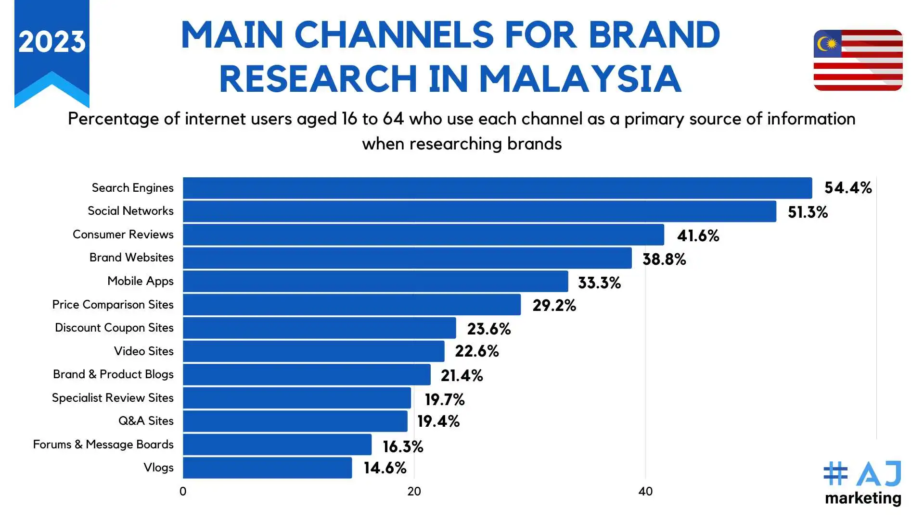
Promotion
Trevon (ajmarketing.io)
Integrated Marketing Campaign:
social media, television, radio, outdoor advertising, and online platforms.
Influencer Partnerships:
Collaborate with local influencers, bloggers, and celebrities

Slide 38
09
Production and Supply Chain

Slide 39
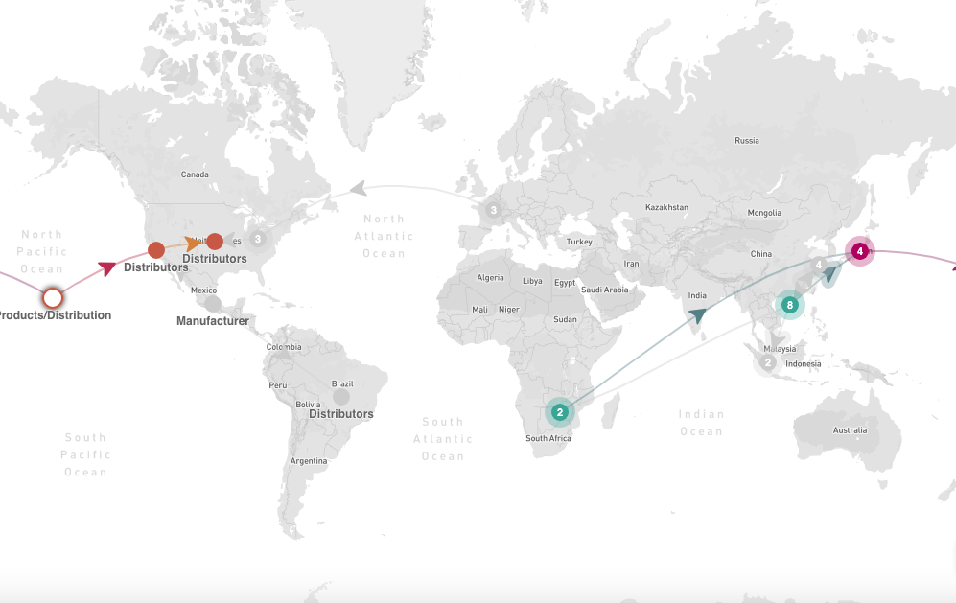
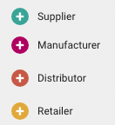
Supplier & Processor & HQ Map Worldwide
Samuel Pak (Sony 2023)
Notes:
**DIFFERENCIATE Distribution Center + Manufacturing Center**
** Create a legend
https://open.sourcemap.com/maps/search/Sony
https://www.google.com/maps/d/u/0/viewer?mid=1nSWp118zylx--XzzESYfT5qbx_s&hl=en_US&ll=20.933128752714307%2C-146.83670007098328&z=3
https://www.sonydadc.com/contact-locations/
Separate the distribution and manufacturer
Create a legend
Hawaii explanation

Slide 40
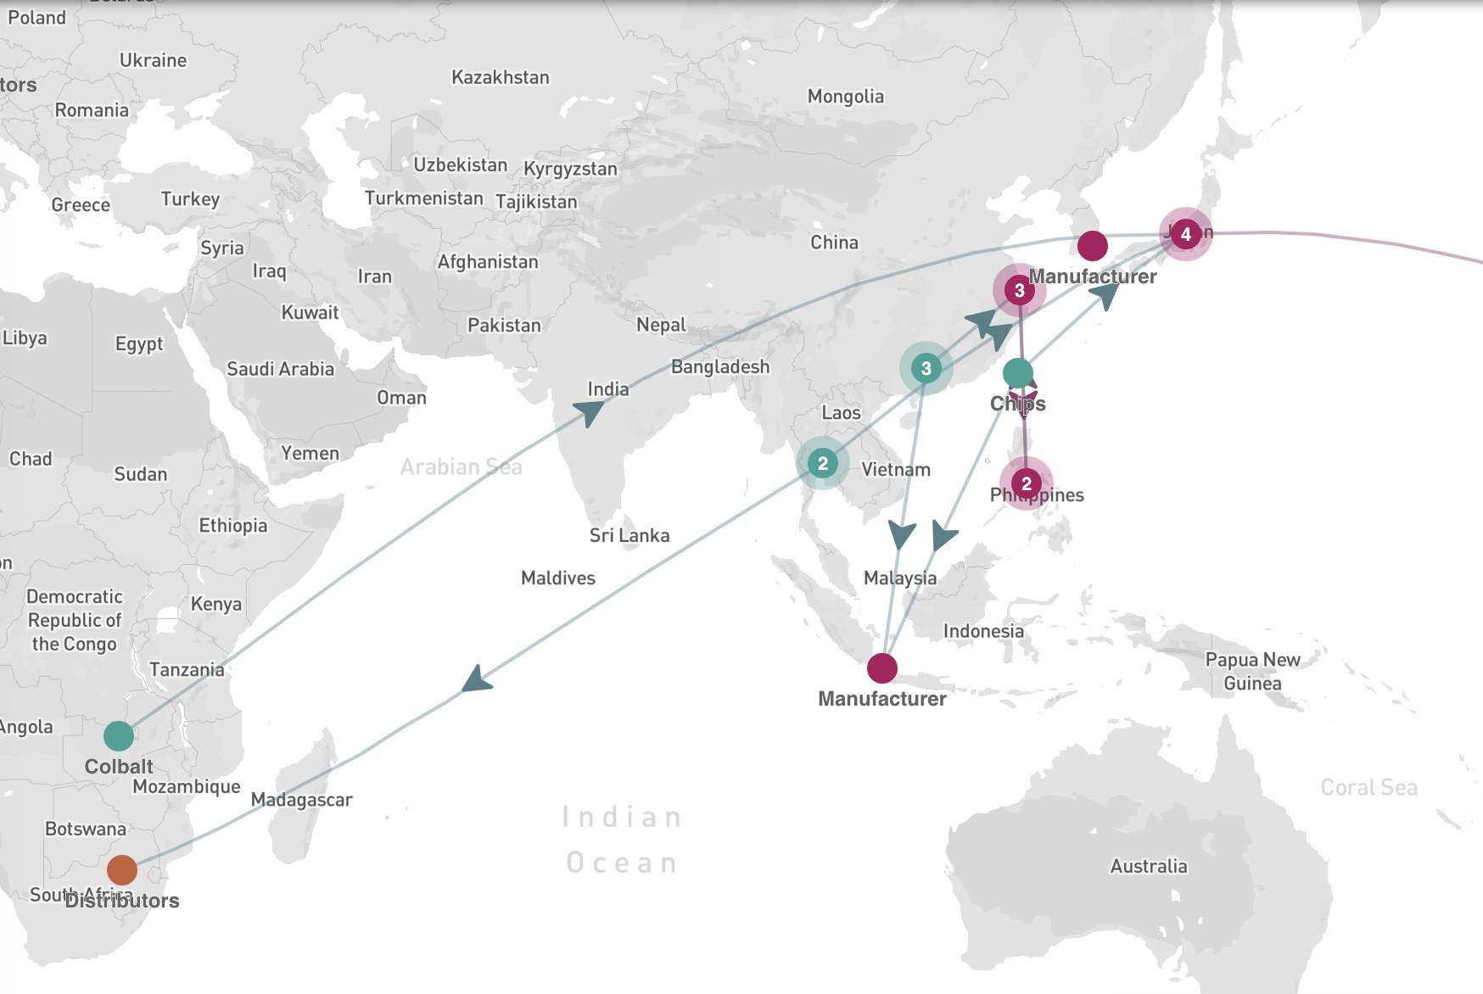
Supplier & Processor & HQ Map Asia
Samuel Pak (Sony 2023)
Notes:
**DIFFERENCIATE Distribution Center + Manufacturing Center**
** Create a legend
https://open.sourcemap.com/maps/search/Sony
https://www.google.com/maps/d/u/0/viewer?mid=1nSWp118zylx--XzzESYfT5qbx_s&hl=en_US&ll=20.933128752714307%2C-146.83670007098328&z=3
https://www.sonydadc.com/contact-locations/
Separate the distribution and manufacturer
Create a legend
Hawaii explanation

Slide 41
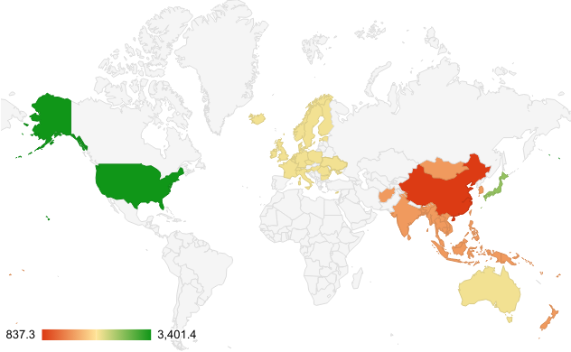
Sony in Asia
Sony’s presence in more than 204 countries
Market capitalization is $101.83 billion in Feb 2023
Sales and Financial Services Revenue
Asia Pacific: $10,109,601,028
China: $5,531.475,668
Japan: $17,407,602,640
SubTotal: $33,048,579,336
Total: $74,621,193,516
Countries by Sony’s Sales & Financial Services Revenue
Samuel Pak (Cascade 2024, Sony 2021, Sony 2024)
Notes:
https://www.sony.com/en/SonyInfo/diversity/program/asia/
https://www.cascade.app/studies/sony-strategy-study#:~:text=Sony's%20market%20share%20and%20statistics,is%20%24101.83%20billion%20Feb%202023
https://www.sony.com.my/microsite/companyoutline/

Slide 42
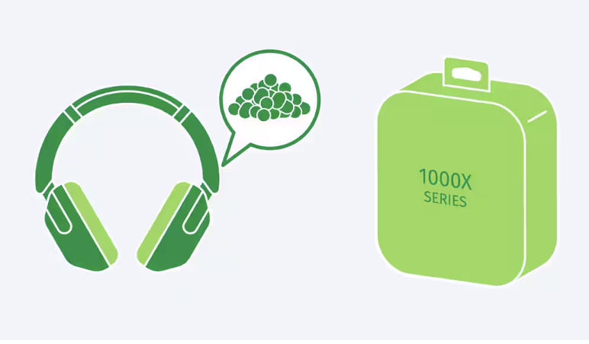
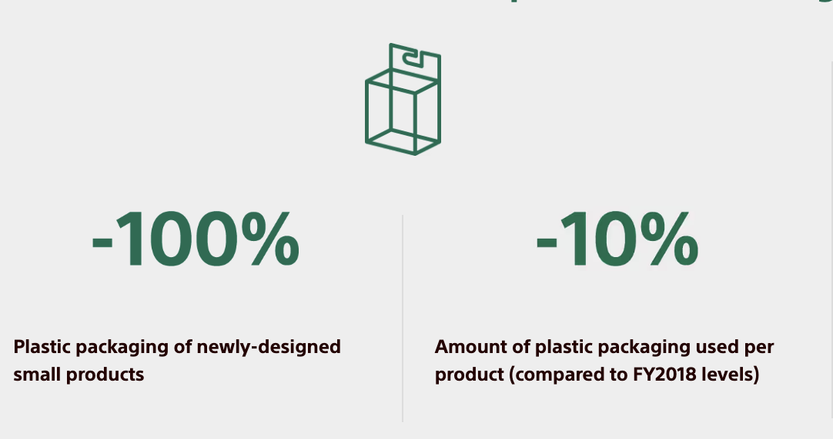
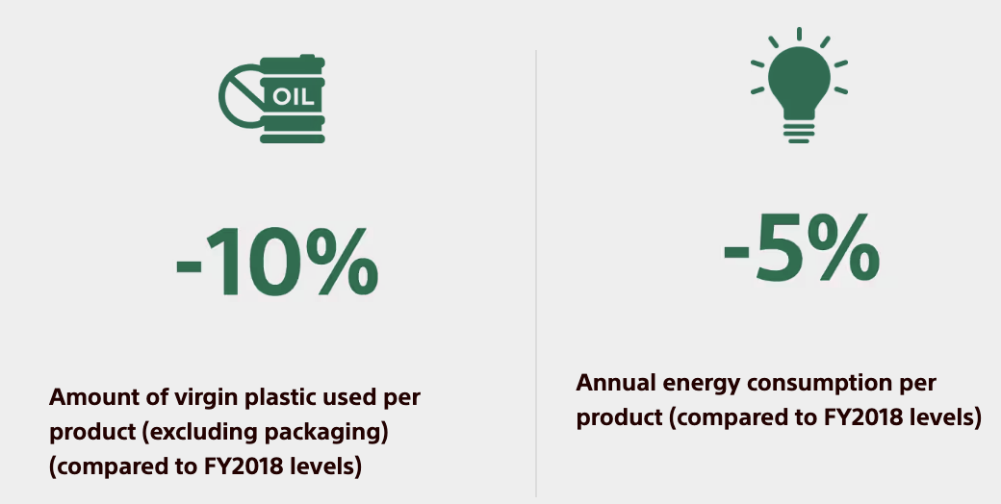
The Three E’s - Ethics, Environment, and Economics
Green Management 2025
“Road to Zero” environmental plan
“Inspire with less energy and fewer resources”
“Converting more electricity from Sony facilities into renewable energy”
“Collaborating with the supply chain to accelerate environmental impact reduction”
Samuel Pak (Sony 2024)
Notes:
MarketRealist
https://www.sony.com/en/SonyInfo/csr/SonyEnvironment/ourvision/GM2025/
PS5: https://www.sony.com/en/SonyInfo/csr/SonyEnvironment/products/ps4.html

Slide 43
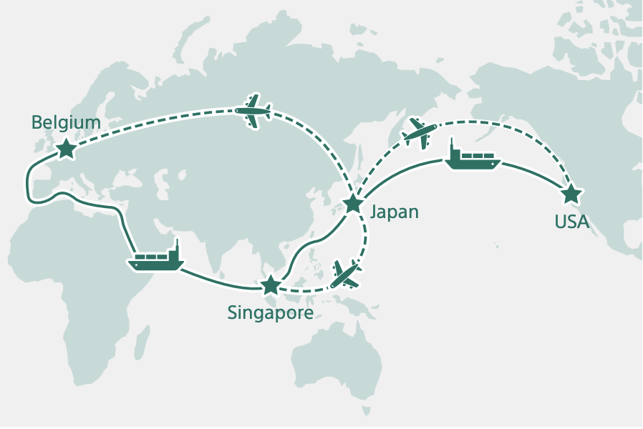
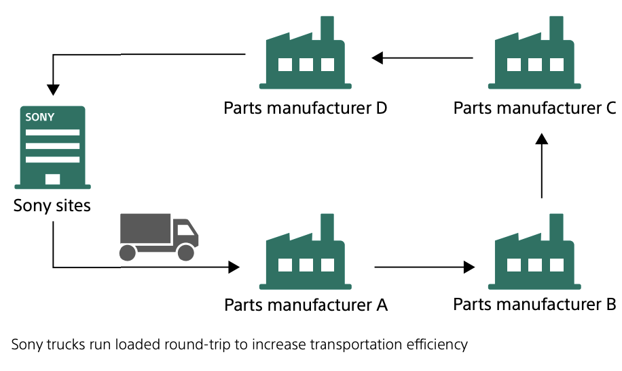
Transportation and Distribution
2020- Switched from air to sea transport from Japan to US, Belgium, and Singapore
Let to reduction of ~695 metric tons of CO2 emission in fiscal year 2022
“Milk Runs” brings greater efficiency + reduces CO2 emission
Main Components: Sorplas, chips,
[Image of Map]
Samuel Pak (Sony 2023)
Notes:
Supply Chain Digital
Axionlog

Slide 44
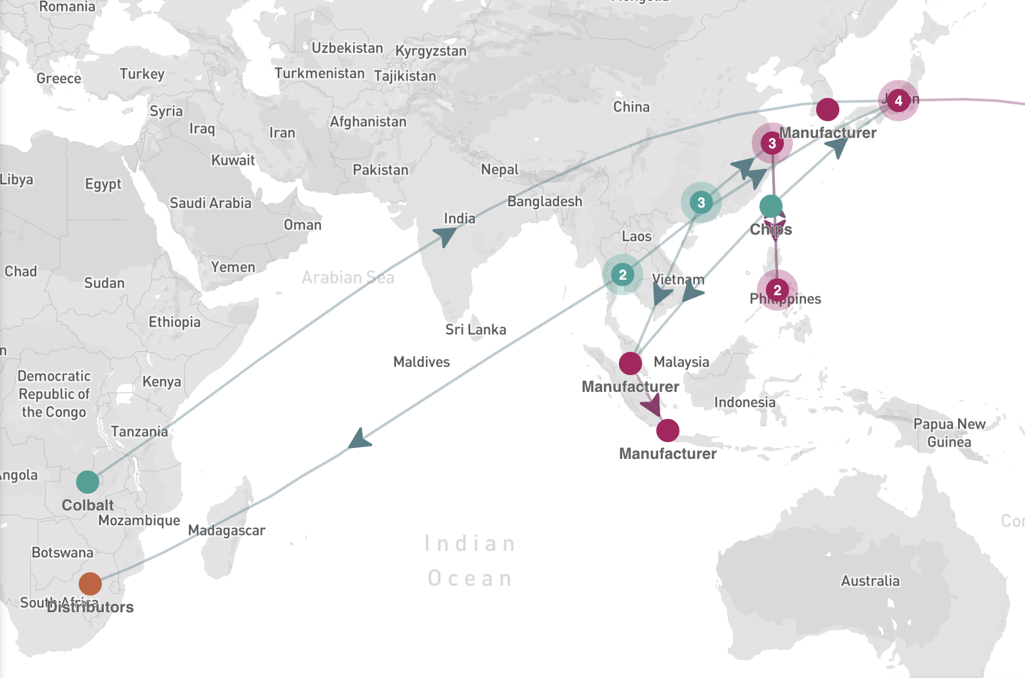
Proposed Supplier, Processor
& HQ Map Asia
Samuel Pak (Sony 2023)
Notes:
**DIFFERENCIATE Distribution Center + Manufacturing Center**
** Create a legend
https://open.sourcemap.com/maps/search/Sony
https://www.google.com/maps/d/u/0/viewer?mid=1nSWp118zylx--XzzESYfT5qbx_s&hl=en_US&ll=20.933128752714307%2C-146.83670007098328&z=3
https://www.sonydadc.com/contact-locations/
Separate the distribution and manufacturer
Create a legend
Hawaii explanation

Slide 45
Thank you
Do you have any questions?
Please keep this slide for attribution

Slide 46
11
References

Slide 47
References
Firm Specific Advantages and Weaknesses
https://www.arcjournals.org/pdfs/ijmsr/v3-i8/7.pdf
https://www.sony.com/en/SonyInfo/csr/library/reports/SustainabilityReport2022_quality_E.pdf
https://bstrategyhub.com/sony-swot-analysis/#Sonys_Strengths
https://edubirdie.com/examples/critical-analysis-of-sony-subsidiaries-and-international-exposure/
https://www.complex.com/pop-culture/a/alex-bracetti/the-9-worst-fails-in-sony-history
https://www.trendmicro.com/vinfo/pl/security/news/cyber-attacks/the-hack-of-sony-pictures-what-you-need-to-know
https://www.cssp.com/lessons-learned-sony-falls-from-market-dominance-loss-of-focus-causes-poor-decision-making/
Sony Production and Supply Chain
https://www.sony.com/en/SonyInfo/csr_report/
https://www.google.com/maps/d/u/0/viewer?mid=1nSWp118zylx--XzzESYfT5qbx_s&hl=en_US&ll=25.139068999999996%2C55.21728499999998&z=8
Chaney, https://www.androidauthority.com/ps5-specs-1133031/
https://www.sony.com/ug/electronics/headband-headphones/wh-1000xm5/specifications
https://www.sony.com/en/SonyInfo/csr/SonyEnvironment/ourvision/GM2025/
PS5: https://www.sony.com/en/SonyInfo/csr/SonyEnvironment/products/ps4.html
https://www.slashgear.com/1533074/amd-processors-and-graphics-where-are-they-made/#:~:text=Taiwan%20Semiconductor%20Manufacturing%20Co.,Perseverance%20Rover%20mission%20to%20Mars.

Slide 48
References
Country Specific Advantages and Weaknesses
https://www.thestar.com.my/news/nation/2023/11/01/children-under-18-make-up-274pc-of-malaysia039s-population-says-stats-dept#:~:text=KUALA%20LUMPUR%3A%20The%20number%20of,total%20population%20of%2033.38%20million.
https://www.privacyshield.gov/ps/article?id=Malaysia-Information-Communications-Technology#:~:text=Malaysia%20aspires%20to%20be%20a,4.0%20and%20Smart%20City%20development.
https://www.populationpyramid.net/malaysia/2023/
https://www.businessgo.hsbc.com/en/article/why-do-business-in-malaysia
https://www.linkedin.com/pulse/challenges-faced-malaysias-public-transportation-system-de-kuyer-3tl5c/
https://nuurrianti-jalli.medium.com/in-east-malaysia-internet-connection-is-still-a-privilege-1b0d73d96671
Current IB Objective
https://www.playstationlifestyle.net/2019/11/08/new-sony-studio-malaysia-2020/
https://apnews.com/article/sony-electronics-japan-movies-ef1e516cd38fb1f0a2869d586fbf8559
https://businessmodelanalyst.com/sony-business-model/#:~:text=Strong%20Distribution%20Network%3A%20Sony%20has,and%20maximize%20its%20sales%20potential.
https://www.shiksha.com/online-courses/articles/international-business-meaning-importance-its-forms/#:~:text=International%20business%20allows%20companies%20to,countries%2C%20contributing%20to%20economic%20development.
https://www.sony.eu/presscentre/sony-accelerates-growth-with-the-expansion-of-its-global-partner-network
Global Strategy
https://www.investopedia.com/terms/s/standardization.asp#:~:text=Standardization%20is%20a%20framework%20of,are%20performed%20within%20set%20guidelines.
https://www.sony.com/en/SonyInfo/blog/2023/08/25/
https://www.sony-semicon.com/en/feature/2022031801.html
https://corporatefinanceinstitute.com/resources/economics/standardization/#:~:text=The%20standards%20ensure%20that%20goods,services%20in%20the%20same%20industry.

Slide 49
References
Marketing 4 P’s
https://www.cia.gov/the-world-factbook/countries/malaysia/
Closing the Loop - Kuala Lumpur City Profile.pdf (unescap.org)
Malaysia: preferred electronic devices to buy 2023 | Statista
https://www.privacyshield.gov/ps/article?id=Malaysia-Pricing
https://www.harveynorman.com.my/customer-services/store-finder.html#KL
Sony Group Portal - Sony History Chapter19 Non-Japanese Directors Join the Board
Malaysia: population by ethnicity 2023 | Statista

Slide 50
References
Geographic Strategies + Proposed International Entry Strategies
https://www.sony.net/Products/di/country/#oceania
https://www.sony.com/en/SonyInfo/CorporateInfo/History/SonyHistory/2-16.html
https://www.sony.com/en_us/sca/who-we-are/overview.html#:~:text=Sony%20Corporation%20of%20America%2C%20located,and%20Sony%20Pictures%20Entertainment%20Inc.
https://companiesmarketcap.com/sony/revenue/
https://www.statista.com/statistics/1260245/sony-gaming-hardware-revenue-global/
https://www.statista.com/statistics/297533/sony-sales-worldwide-by-business-segment/
https://www.genting.com/leisure-hospitality/
https://www.statista.com/statistics/1386073/malaysia-preferred-electronic-devices-to-buy/#:~:text=According%20to%20a%20survey%20conducted,would%20purchase%20this%20electronic%20device.
https://www.gsmarena.com/sony_details_its_mobile_strategy_going_forward_lists_countries_its_pulling_out_of_-news-37140.php#:~:text=At%20their%20expense%2C%20Sony%20is,certain%20strategy%20to%20do%20so.

