Slide 1




Chapter 11
Communication
Nhu Vo, Y Ha, Ai Nhi Vu, Minny Vo , & Ngoc Ho

Slide 2




Introduction to Communication
  What is Communication?
    Sharing information to reach a common understanding.
    Importance of accuracy over mere agreement.

Slide 3

Introduction to Communication
  Functions of Communication:
    Providing knowledge
    Controlling and coordinating
    Motivating and expressing feelings
  Example: Miscommunication in healthcare settings, where unclear instructions can result in medication errors or patient safety issues.

Slide 4

Types of Interpersonal Communication
  Communication is vital to organizational success
  Three primary types of communication in an organization:
    Oral communication (Meetings, conversations, speeches)
    Written communication (Emails, messages, documents)
    Nonverbal communication (Body language, expressions, space)
  Each type serves different purposes and has unique advantages

Slide 5
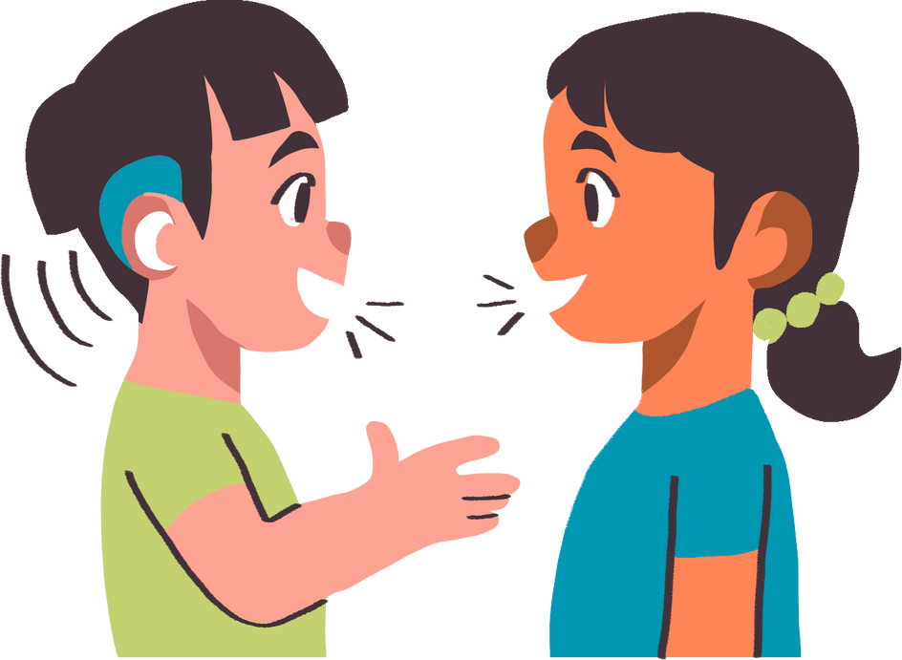
Types of Interpersonal Communication
Oral Communication
  Direct verbal exchange between individuals
  Can be synchronous (real-time) or asynchronous (recorded)
  Conversations and discussions / Meetings and speeches / Phone calls and voice messages
    Active listening: engaging in sensing and processing others’ messages
    Reflective listening: acknowledging, restating, or reformulating others’ messages

Slide 6

Types of Interpersonal Communication
Written Communication
  Includes letters, emails, instant messaging, blogs, and newsletters
  Creates long-term records or enables quick information exchange
  Even small written communications can significantly impact motivation
  Help make thoughts concrete and promote thoughtful reflection
  For example:
  Mail: Employees spend an average of 3 hours daily checking email (37.5% of the workweek)
  Instant messaging: Slack users spend ~10 hours per weekday on the application

Slide 7

Types of Interpersonal Communication
Nonverbal Communication
(Enhances all communication, conveys emotions)
  Body language and facial expressions
  Use of space and time
  Communicates:
    Status and engagement
    Emotions and attitudes
    Often believed over verbal messages when in conflict

Slide 8

Barriers to Effective Communication
  Culture
  Misinterpretation of nonverbal communication
  Defensiveness
  Lack of feedback and clarification
  Poor listening skills

Slide 9

Barriers to Effective Communication
  Improving Listening:
    Active listening techniques: giving undivided attention, asking clarifying questions, and rephrasing key points.

Slide 10



Virtual Communication and Social Media

Slide 11

Forms of Virtual Communication
What is Virtual Communication?
  Virtual communication is any communication that happens through digital tools such as:
    Videoconferencing
    Emails and messaging apps
    Blogs, vlogs, and podcasts
    E-learning and collaboration platforms

Slide 12
Smartphones, Social Media, and Cybersecurity
Smartphones
Social Media
  Over 2.5 billion users globally
  Improves connectivity and access
  Challenges:
    Blurs work–life boundaries
    Increases stress and reduces focus
    Causes technoference (disruptions from constant notifications)
  Other smart devices (smartwatches and smart assistants) also impact workplace communication
  Using by 3.5 billion people (~45% of the world’s population)
  More than a tool — it shapes how we communicate and how people see us
  Key points:
    Reflects personality & values
    Can lead to surface-level thinking (shallowing hypothesis)
    Impact a company reputation — be responsible online

Slide 13



Smartphones, Social Media, and Cybersecurity
Cybersecurity
  Online communication increases security risks
  Companies should:
    Understand threats
    Build a strong cybersecurity culture
    Monitor activity to protect systems
  Employees should:
    Be careful of what they share
    Stay alert and protect personal privacy

Slide 14

Cross-Cultural Communication
  Understanding Cross-Cultural Communication:
    High vs. Low-context cultures (communication styles).
    The importance of mutual respect and sensitivity to cultural differences.

Slide 15

Cross-Cultural Communication
  Best Practices for Cross-Cultural Interaction:
    Be aware of cultural norms, communicate with openness, and foster mutual understanding.

Slide 16


Conclusion
  Communication is a vital part of every organization
  Different types of communication, from oral to written and nonverbal
  Barriers like cultural differences and poor listening can hinder effective communication
  Technology, while incredibly useful, also presents new challenges in terms of virtual communication and device overload
  Cross-cultural communication requires an open mind and sensitivity to cultural differences

Slide 17

Thank You for Listening!

